Slide 1




Notes:
This presentation is designed to provide the basis for a discussion around the CORE HEALTH AND SAFETY VALUES in Vision Zero. It starts with a few slides that provide an overview of the key elements of Vision Zero and help ensure that we all have a common understanding of what it is. This will provide the background for the discussion around the core values. Remind everyone why Vision Zero is important – we all want to go home safe and well everyday. It would be ideal to have the printed leaflet and Vision Zero card available to hand out at the end of the session. You will need an WIFI link to view the video on the second slide. If not available suggest you delete the second slide.

Slide 2
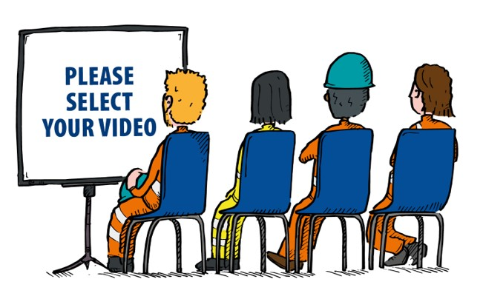
View the video for a quick overview
Click here
Notes:
This short video provides a graphic visual summary of Vision Zero. If you do not have a WIFI / internet link suggest that you delete the slide but let people know they can view the videos about Vision Zero on Safequarry.

Slide 3


Vision Zero explained
What is the main objective of Vision Zero?
Everyone
Safe & Well Every Day
Who is involved?
Everyone has a part to play - managers, supervisors, operatives, contractors
We are all responsible for our own and our colleagues health and safety
Notes:
Main purpose of this slide is to highlight what the ultimate goal of Vision Zero is and to emphasise to the audience that everyone has a key role to play in achieving Vision Zero

Slide 4
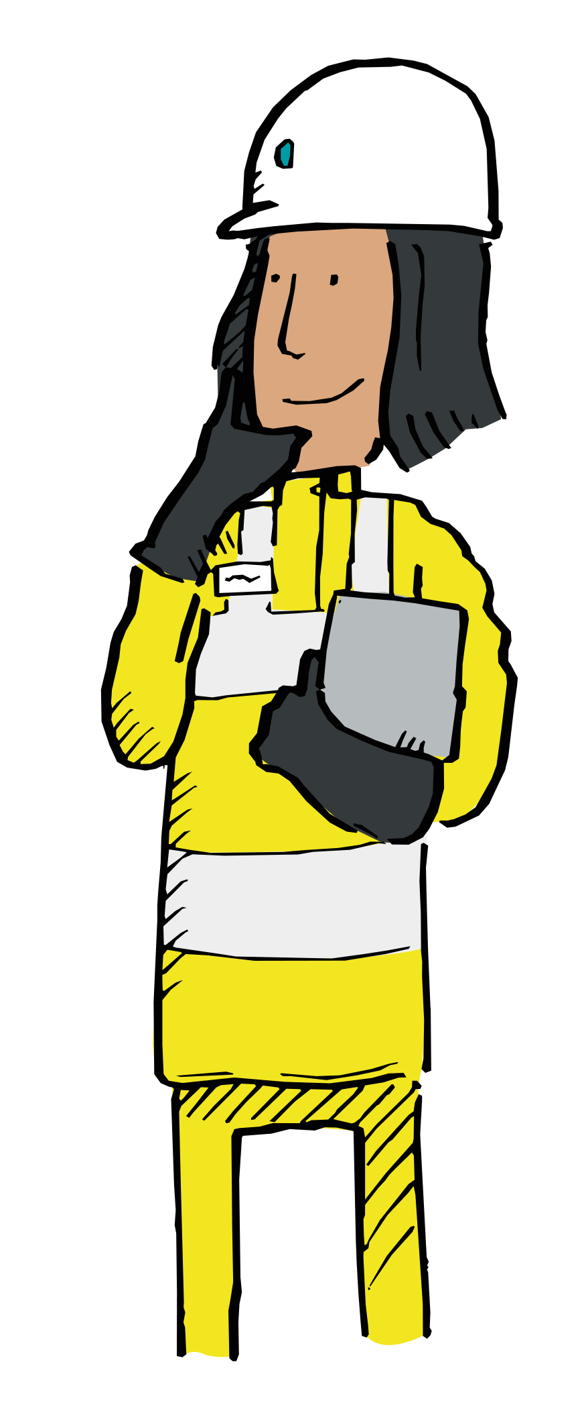
How will Vision Zero be realised?
Embracing 6 Core H&S Values
Focusing on the ‘The Fatal 6’
Following 6 complimentary MPA Strategies
Monitoring Leading and Lagging indicators to track our progress
Notes:
Whilst Vision Zero incorporates all the elements above this presentation is focussed on the 6 core H&S values. By adopting these values we will help to ensure that everyone in the organisation is committed to health and safety and will start changing their behaviour in relation to their own and their colleagues health and safety. They have been agreed by MPA members and reflect the values that many organisations already embrace.

Slide 5
CORE VALUES
Notes:
You might consider discussing with the audience what is a shared value? Answers might be along the lines of:
Shared values can help to create trust, shared understanding and help link employees and organisations together.
“This is the way we work together”.
“These are the work attitudes and principles that we all agree upon and which we value”.
Employees share a common work attitudes and principles with their colleagues. This can help to build a feeling of camaraderie and a shared interest in success”
The shared values will help us to hold one another accountable and provide feedback in a positive way

Slide 6
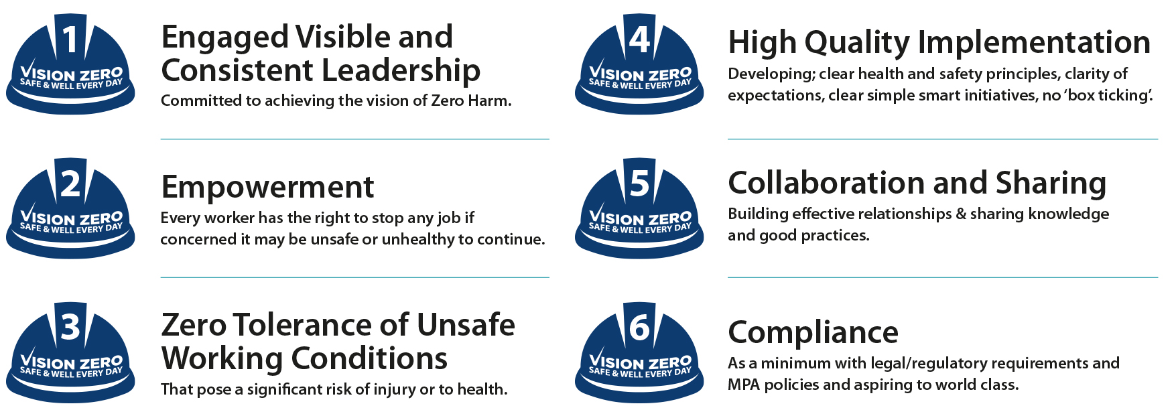
What are the 6 core MPA Health and Safety values?
Notes:
This is a summary slide – the following slides look at each core value individually. As you progress through the next six slides you could consider the following.
Asking the audience –for examples of these values being demonstrated in their workplace – or examples of failing to follow them.
Asking how could things be changed in their work place to help change behaviour or ways or working to reflect these values?
Asking if they can think of 1 or maybe 3 things that they or the organisation/team could do that would show commitment to these values.
It is important to emphasise that Vision Zero is about everyone in the organisation from the MD downwards living and working with these values. The notes provide a little bit more background to the each of the core values and hopefully will help you to facilitate the discussion.

Slide 7
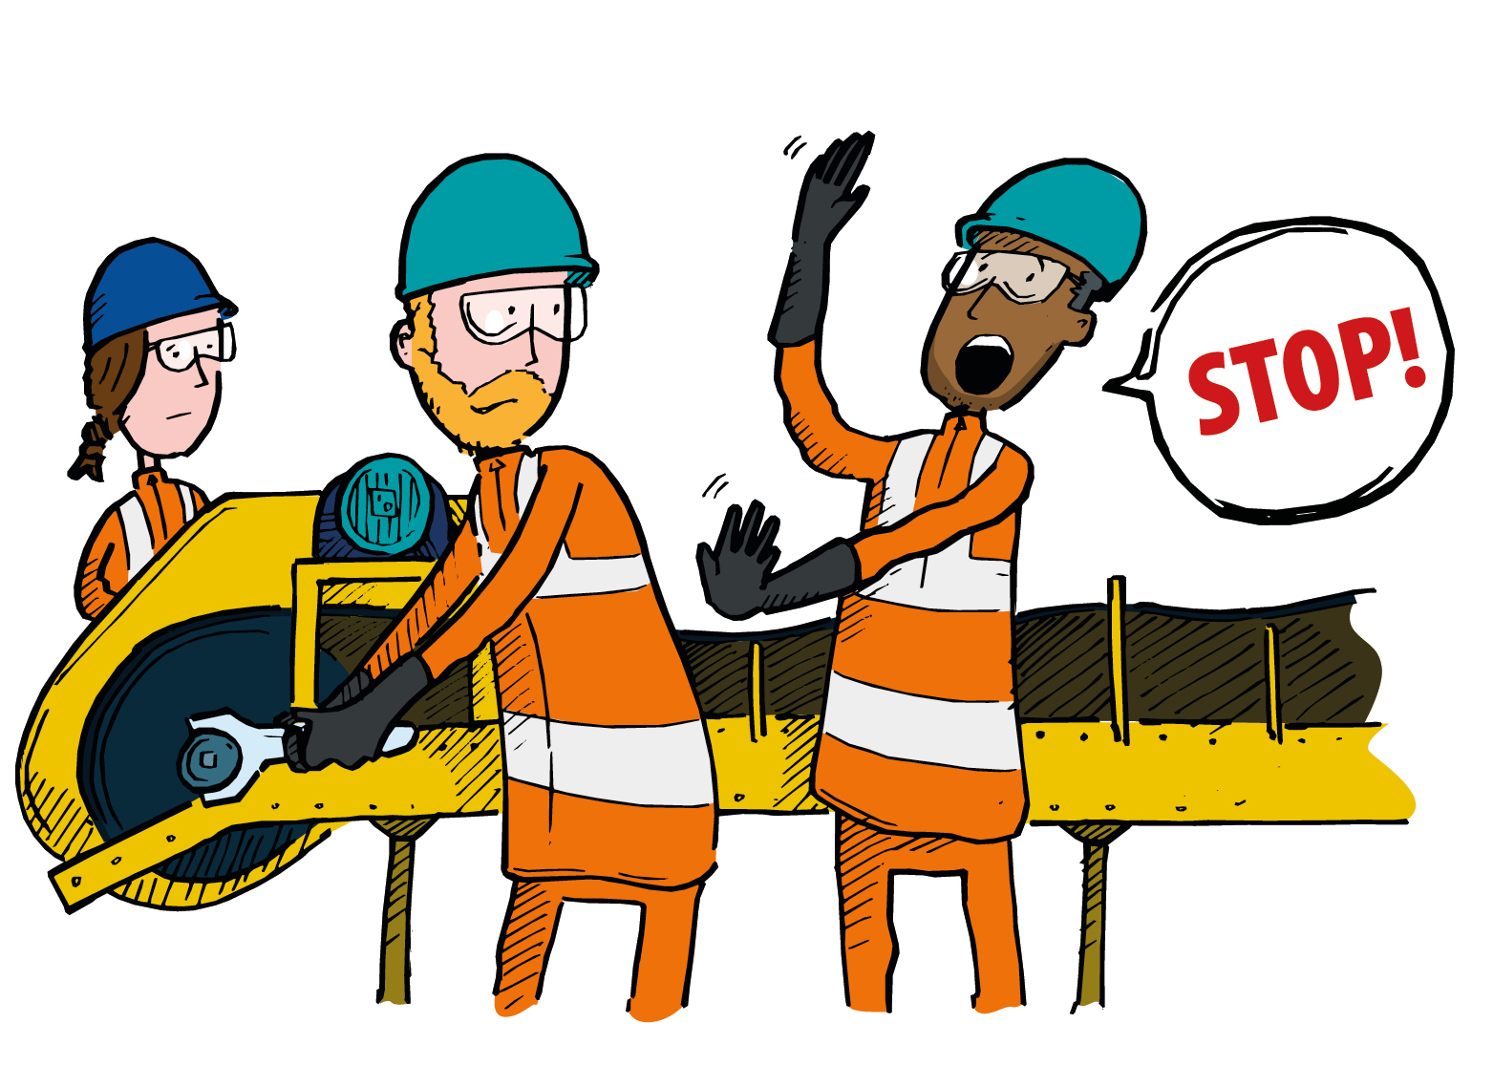
1. Empowerment - Every worker has the right to stop any job if concerned it may be unsafe or unhealthy to continue.
Notes:
You could ask open questions as suggested in the notes on the summary slide 6. Key point - If you feel concerned that you and/or your workmates may be at risk whilst carrying out a task, or if you see anyone acting unsafely, then ‘step in’ and stop the job until everyone can be sure that proper controls are in place
- This is a slide that presents a good opportunity to have a discussion on whether people would feel comfortable to step in and stop a job – even with production pressures, challenging managers, supervisors etc. Would younger workers or new starters feel comfortable challenging unsafe working practices in your workplace

Slide 8
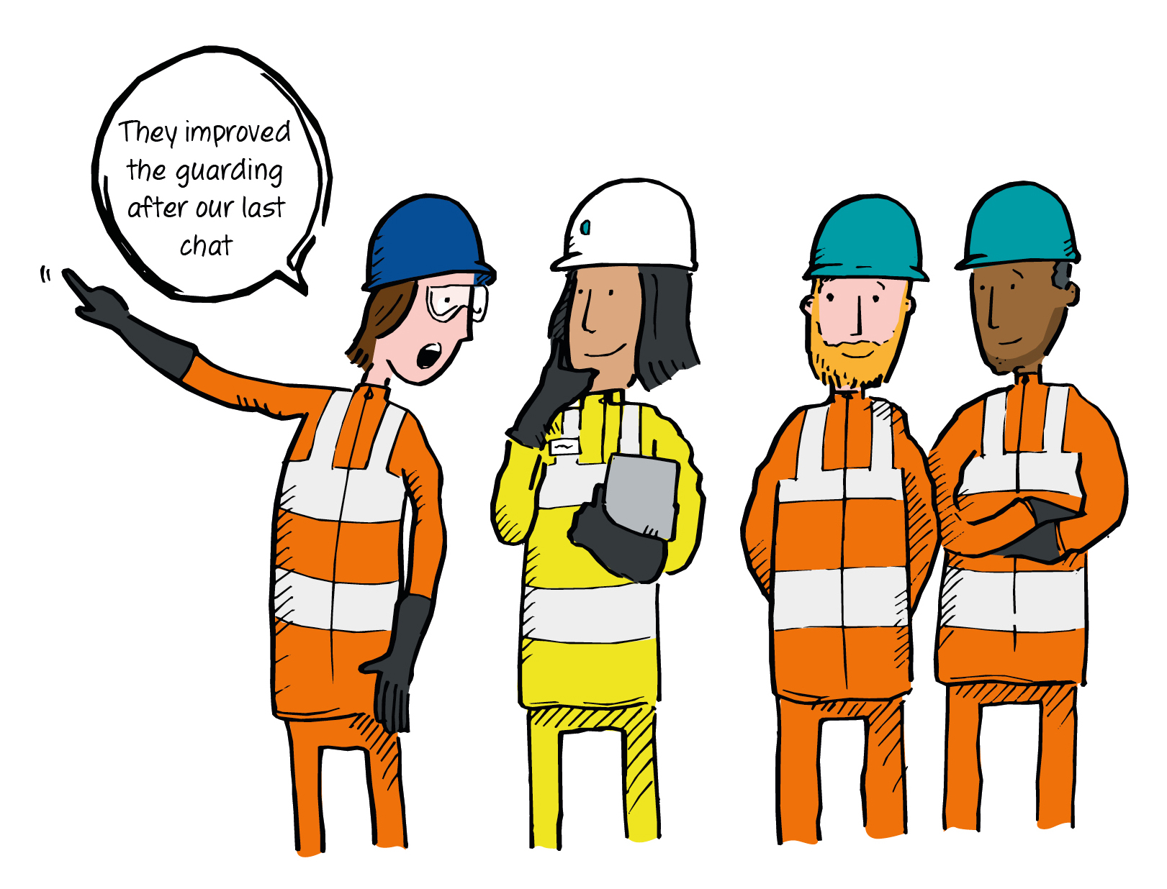
2. Engaged Visible and Consistent Leadership
Committed to achieving the vision of Zero Harm.
Notes:
You could consider asking one of the open questions on the summary slide 6 – The key point; Good leadership is key to good health and safety. We can all be leaders in our own workplaces by visibly adopting the values and always setting a good example to others. Managers and supervisors should take care to engage with, and listen to, concerns of the workforce, visibly demonstrating their commitment to making workplaces safer and healthier for all.

Slide 9
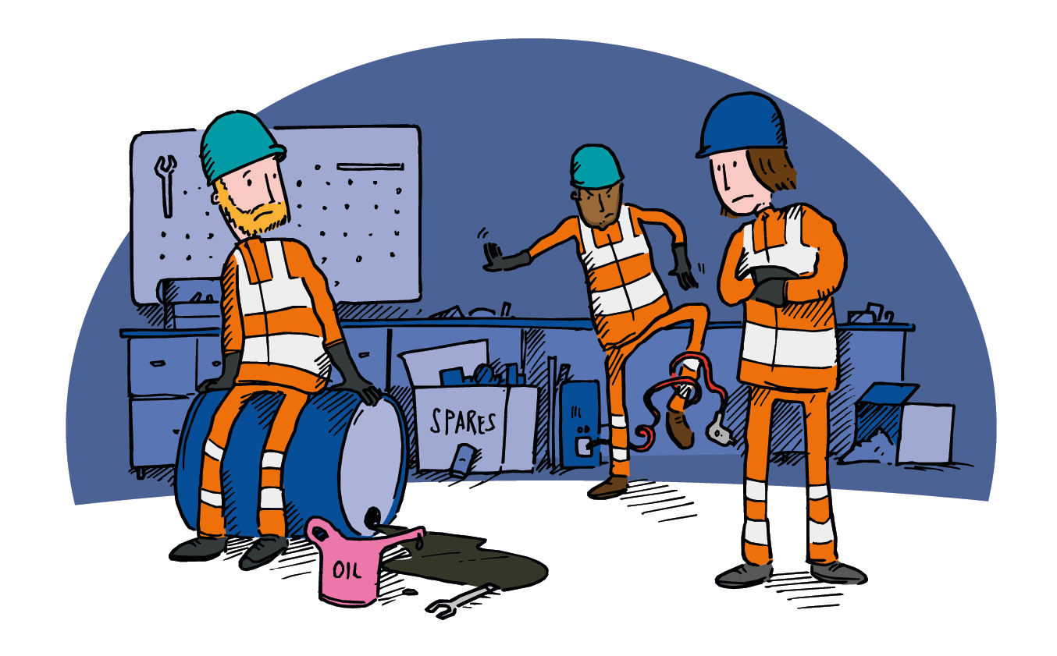

3. Zero Tolerance of Unsafe Working Conditions
That pose a significant risk of injury or to health.
Notes:
You could consider asking one of the open questions on the summary slide 6 – The key point/s/; We can all play our part in making our workplaces safer and healthier for example by cleaning, tidying up and keeping designated access routes clear. If you see a problem that you feel you cannot tackle safely or is not within your authority then ensure it is reported to your line manager.
This slide provides the opportunity to discuss what constitutes unsafe working conditions – who sets the benchmark

Slide 10
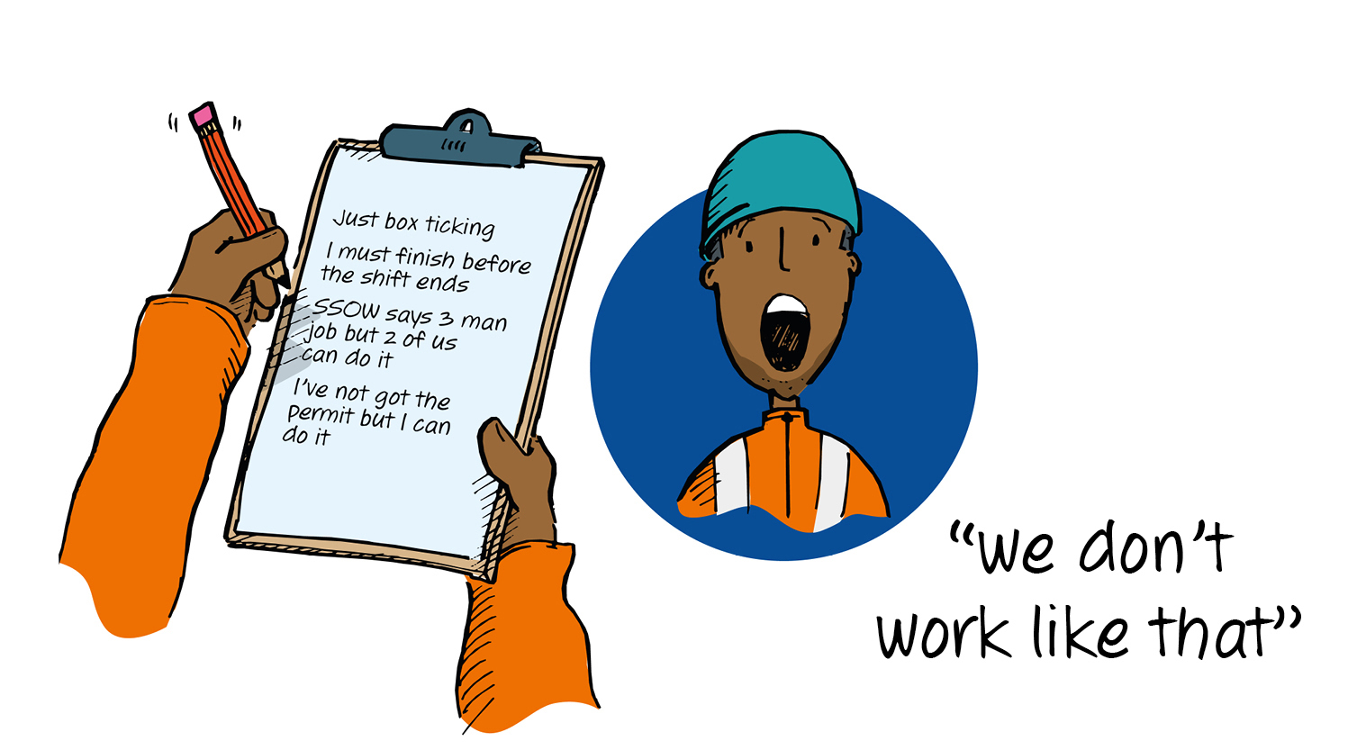
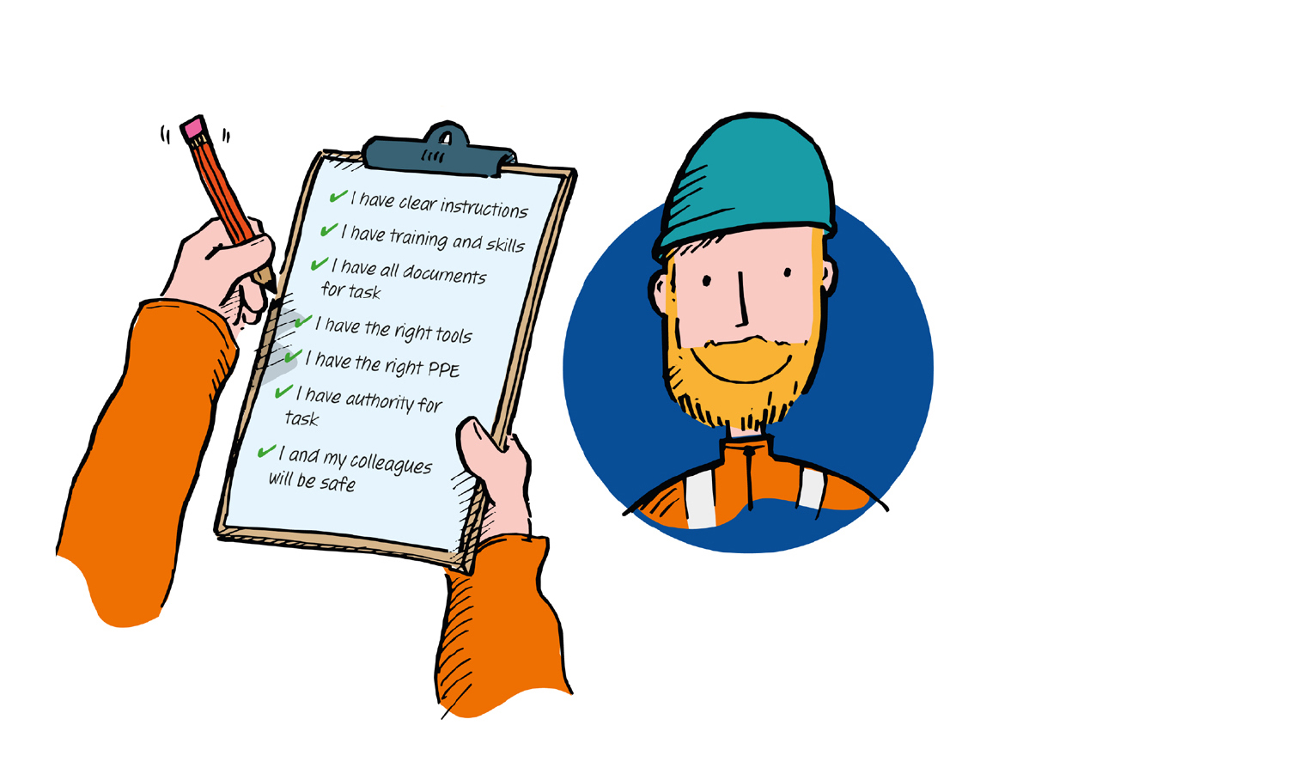
4. High Quality Implementation
Developing; clear health and safety principles, clarity of expectations, clear simple smart initiatives, no ‘box ticking’.
Notes:
You could consider asking one of the open questions on the summary slide 6 – The key point/s/; High quality implementation is about checking that we have the right training and competences, taking care to follow rules and procedures properly, ensuring we have the right tools for the job and wear the correct PPE. By taking shortcuts or just ‘ticking the boxes’ we significantly increase the chances of a serious incident occurring.
A good slide to generate discussions on examples which can become box ticking. ….are you as thorough with your start of shift loading shovel checks when there are a line of trucks waiting to be loaded etc

Slide 11

5. Collaboration and Sharing
Building effective relationships & sharing knowledge and good practices.
Notes:
You could consider asking one of the open questions on the summary slide 6 – The key point/s/; There are many ways we can share or collaborate to make our workplace safer or healthier for example; Sharing our knowledge and experience with others. Sharing our good ideas about how things might be improved. Reporting our mistakes so that everyone can learn from them and prevent them occurring in the future. Actively participating in events such as safety days or toolbox talks
You could use this slide to make the point that the knowledge usually exists within a workforce but it just needs sharing…..no ‘knowledge is power’ attitude. Don’t assume everyone understands.

Slide 12
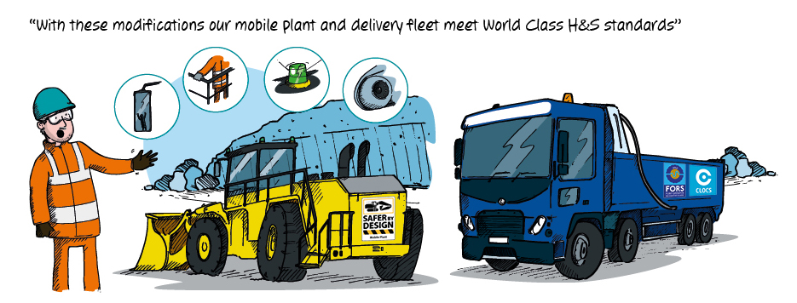
6. Compliance
As a minimum meeting all legal and regulatory requirements and MPA policies and aspiring to be world class.
Notes:
You could consider asking one of the open questions on the summary slide 6 – The key point/s/; As individuals and organisations we can all strive to perform to the best of our ability, exceeding the standards and statutory duties that only reflect the minimum that is acceptable.
You could ask the audience a general question about what they think they need to comply with – the law, policy, risk assessment, operating procedures etc. Any conflicts?

Slide 13

What resources are available on Vision Zero?
Videos and other resources on www.Safequarry.com provide an overview of key elements of Vision Zero
The Employee guide provides a quick reminder and summary of Vision Zero
Notes:
This would be a good time to hand out the resources and possibly link to Safequarry to show them where they can view the on-line resources

Slide 14


Keep the Vision Zero card on your desk, in your vehicle or in your pocket as a reminder
Notes:
Hand out the card if you have them (they can be ordered from david.yelland@mineralproducts.org) - Urge them to regularly review the items on the card. Ask them where they could put it so they see it on a regular basis. If you do not have the card this slide can be used as a useful summary and reminder for the audience.

Slide 15

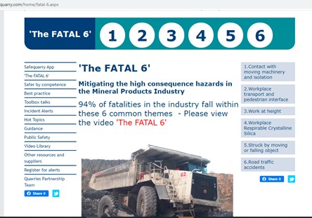
www.Safequarry.com & Safeprecast.com
Safequarry also provides lots more information on ‘The Fatal 6’ and much, much more..
Notes:
If you have time this would be a good opportunity to also show them the Safequarry website and remind them that they can get more information on Vision Zero and view the resources by going to the Visin Zero section. You could mention that they could visit ‘The Fatal 6’ section of Safequarry where they can see Guidance, best practice, incident alerts that relate to each of ‘The Fatal 6’. Please recommend that they register on Safequarry to receive incident alerts, toolbox etc. Or have a look at the site when they have the time. It is the central hub for health and safety information for the mineral products industry. Emphasise that SQ is a unique resource which is the product of input/contributions from across the industry

Slide 16
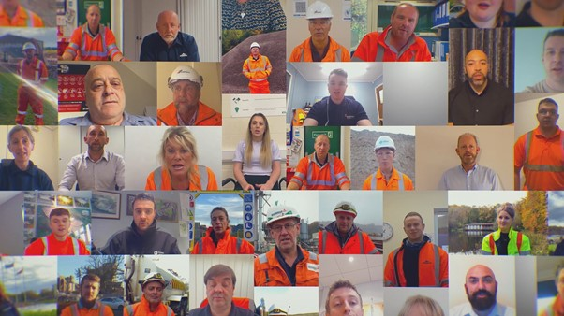
Vision Zero - views from your colleagues from across the industry about H&S
Click here
Notes:
Powerful short video that reflect on the importance of health and safety – a good way to close the Toolbox talk or to ask them what they think about the core values or ‘The Fatal 6’ – hopefully this will facilitate an open discussion.

Slide 17
Notes:
You could say that this presentation and their participation is a good example of the core value – ‘collaboration and sharing’. Thank them for their contribution and remind them that the resources can be viewed on Safequarry. As a closing remark you could say that Vision Zero involves us all and will help ensure that we all go home ‘Safe and Well Every Day’

