Slide 1
Defining the Danger Zone for Blasting. Guidance on what to consider when determining the danger zone for quarry blasting .
Drilling and Blasting
Toolbox Talk : 06
Updated Feb 2020
Target Audience
Shotfirers, Explosives Supervisors and Quarry Operators.
This toolbox talk may be freely reproduced except for advertising, endorsement or commercial purposes. It has been developed by the Quarries National Joint Advisory Committee (QNJAC) to help quarry operators, contractors, managers and others make health and safety improvements in the quarry industry.
This guidance represents good practice which may go further than the minimum you need to do to comply with the law.
If you use the information provided in this document please acknowledge ‘QNJAC’ as the source .

Slide 2
Defining the danger zone for blasting 1. Introduction
All blasting operations must have a declared danger zone.
The rules for shotfiring operations should include a procedure for the determination of the danger zone
The extent of the danger zone may be shown on a suitable plan and is the recommended means, but must be included in the Blast Specification.
Areas outside the quarry boundary may need to be included in the danger zone

Slide 3
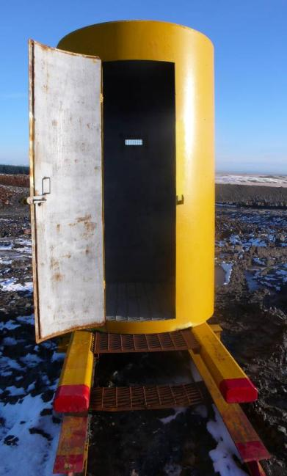
Defining the danger zone for blasting 1. Introduction
The danger zone is an area in which there must be no personnel during the blast.
The inside of a Shotfiring Shelter or a Safety Refuge are not considered to be part of the danger zone.
Photo courtesy of Aggregate Industries

Slide 4
Defining the danger zone for blasting 1. Introduction
Some quarries may also have provision for a Safe Refuge within the danger zone where it is safe for the quarry personnel and other visitors to shelter during the blasting process.
It is important that the establishment of a Safe Refuge is the subject of a detailed Risk Assessment and that the structure employed is of sufficient strength to prevent the ingress of flyrock.
Equally important is that the operation of such a refuge is covered by the shotfiring rules especially
Appointment of a sentry to control the refuge
Communication between the refuge sentry and the shotfirer

Slide 5
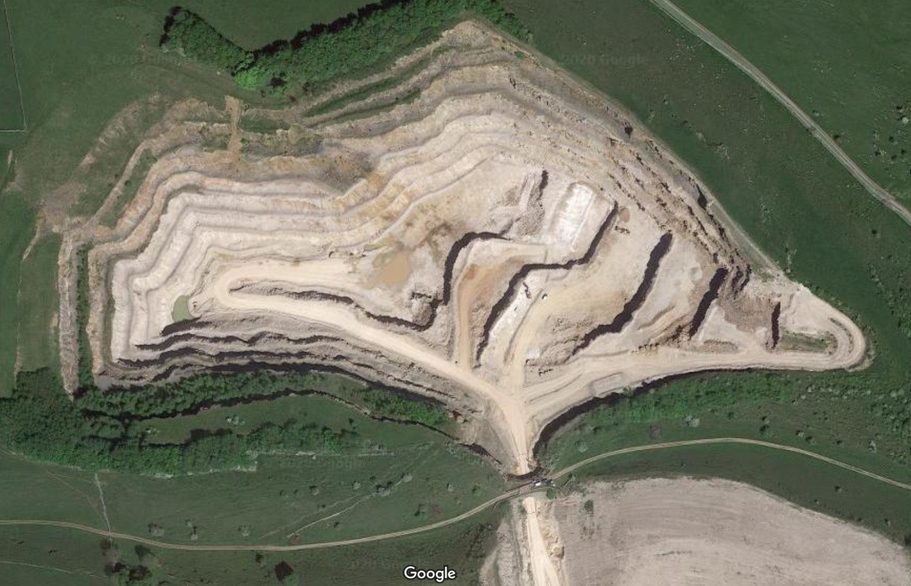
Defining the danger zone for blasting 2. Basics
The danger zone needs to be as large as necessary
In the example below the danger zone extends outside of the quarry boundary and includes access land and a public footpath which would need to be controlled

Slide 6
Defining the danger zone for blasting 2. Basics
The danger zone needs to be controllable
Sentries must be able to see / control all parts of the danger zone that they are responsible for.
For more information on sentry duties see TBT 07 Controlling The Danger Zone and the Duties of Sentries

Slide 7
Defining the danger zone for blasting 3. Factors to consider
Ask yourself
Has the quarry had any issues in the past ?
Have there been any issues loading the blast holes ?
Are you satisfied with the size of the danger zone ?
The QUARRY Operator, Explosives Supervisor and Shotfirer should agree on the determined danger zone and sentry positions.
The danger zone will need to be carefully assessed especially when there have been changes in normal blasting operations or different areas of the quarry being worked.

Slide 8
Defining the danger zone for blasting 4. Public areas
The location of roads, footpaths and the quarry boundary should not determine the limit of the danger zone
If the determined danger zone extends outside of the quarry boundary then consideration needs to be given on how this area can be controlled
Public footpaths and road will need sentries where they enter and leave the danger zone.
It is likely a sentry or other person will need to travel a footpath or road to make sure nobody is present before firing
Special consideration may need to be given to any structures within the danger zone
For example : buildings, tunnels, etc.

Slide 9
Defining the danger zone for blasting 5. Key Points
The danger zone should be as big as necessary
The danger zone needs to be controllable
If in doubt then make the danger zone larger
The danger zone should not be one of convenience

