Slide 1
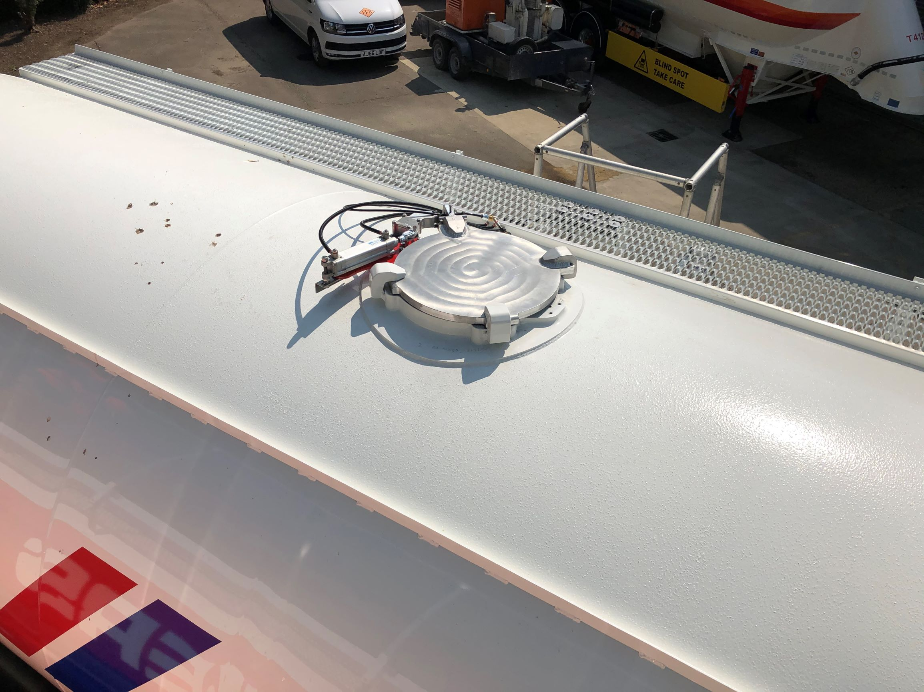
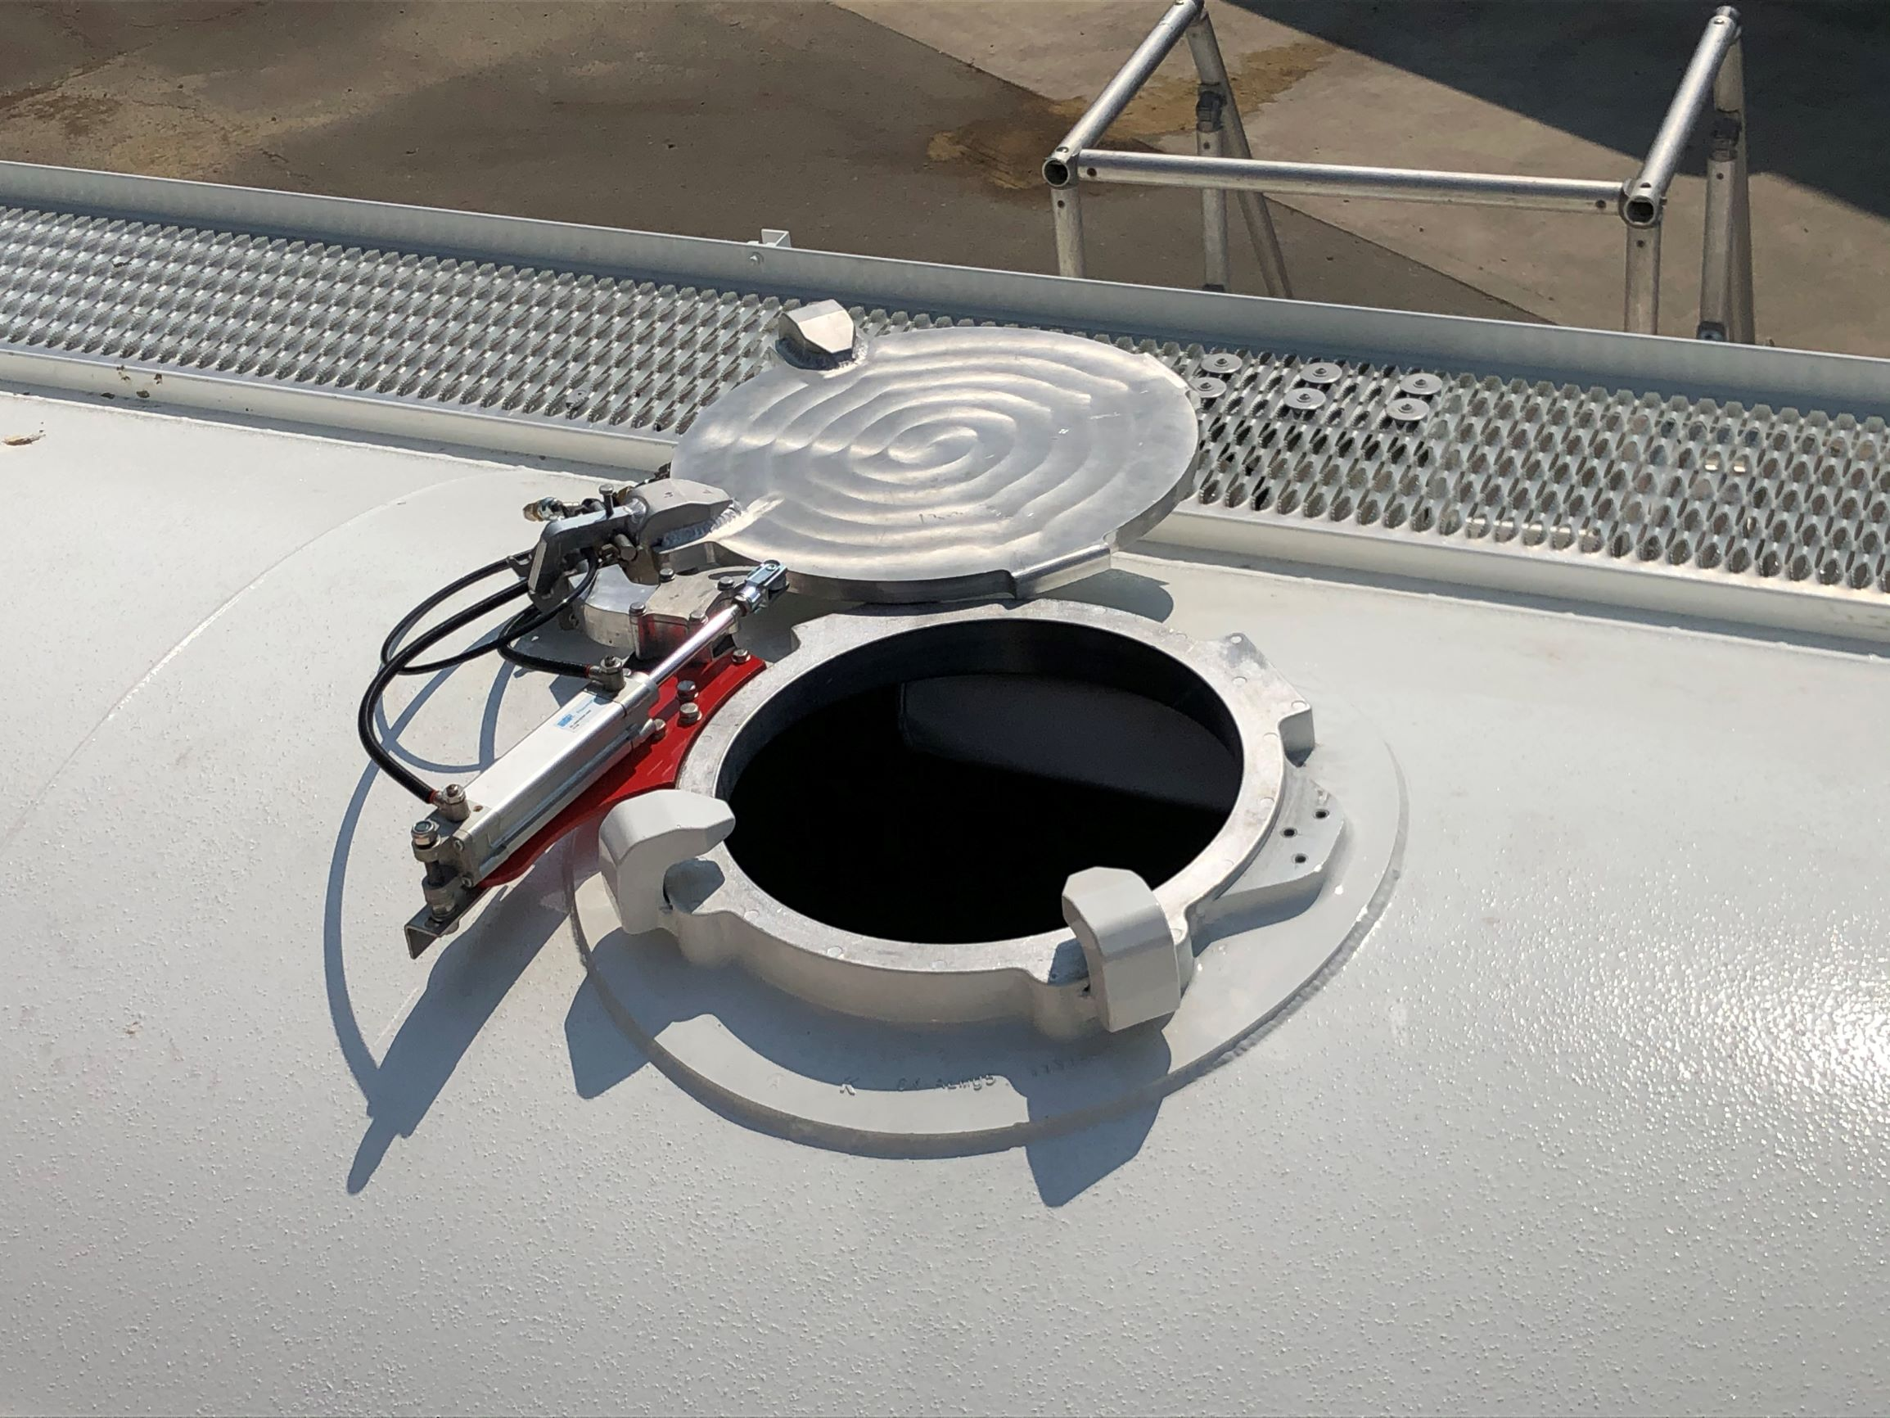
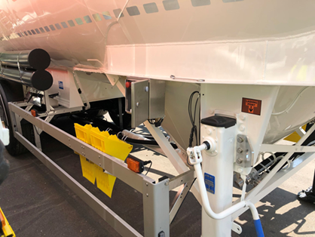
MPA Awards – Auto lids for bulk cement loading
PLEASE SCAN FOR VIDEO
Ground based control panel

