Slide 1
Guidance for Quarry Personnel on the Discovery of Misfired Explosives Information on how to recognise misfired explosives discovered during the quarrying process and what steps to take.
Drilling and Blasting
Toolbox Talk : 04
Updated February 2019
Target Audience
All quarry personnel.
This toolbox talk may be freely reproduced except for advertising, endorsement or commercial purposes. It has been developed by the Quarries National Joint Advisory Committee (QNJAC) to help quarry operators, contractors, managers and others make health and safety improvements in the quarry industry.
This guidance represents good practice which may go further than the minimum you need to do to comply with the law.
If you use the information provided in this document please acknowledge ‘QNJAC’ as the source .

Slide 2
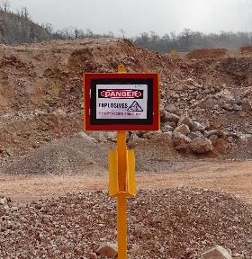
Misfires : Guidance for Quarry Personnel
Explosives and detonators are widely used in the quarrying industry and may occasionally be found during the quarrying process – these are known as misfires.
Misfires have the potential to be detonated by impact and such an event can have serious consequences
Quarry personnel need to be able to recognise a misfire and to understand what steps to take in the event of finding one
Only trained and competent people should deal with misfires

Slide 3
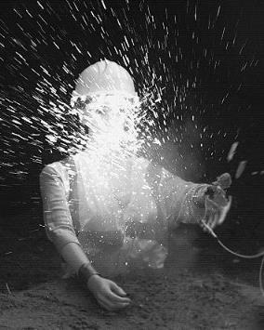
Misfires : Guidance for Quarry Personnel
A reminder about the power of detonators
Press the ‘pg dn’ button to play video
Press the ‘pg up’ and then ‘pg dn’ buttons to re-play video

Slide 4
Misfires : Guidance for Quarry Personnel
A reminder about the power of explosives
In this video about the amount found in a typical booster used in quarries
Press ‘pg up’ and then ‘pg dn’ to repeat video
Press the ‘pg dn’ button to play video

Slide 5
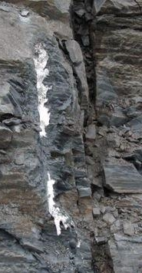
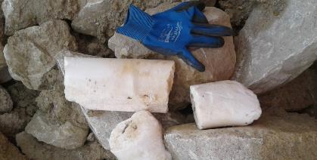
Misfires : Guidance for Quarry Personnel What am I looking for ?
Here are some photographs showing misfires to give you some idea of what to look out for :
Bulk explosives :
In general you will see these as just dry white powders or smears of a porridge like substance

Slide 6
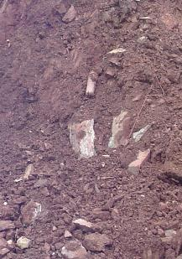
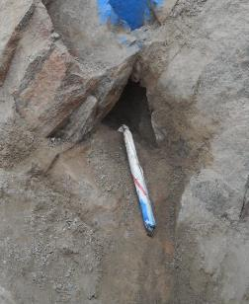
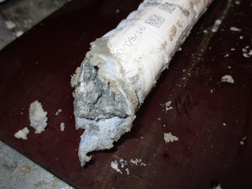
Misfires : Guidance for Quarry Personnel What am I looking for ?
Packaged explosives :
These are generally seen as a plastic wrapped sausage and can be in a range of diameters.

Slide 7
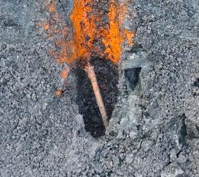
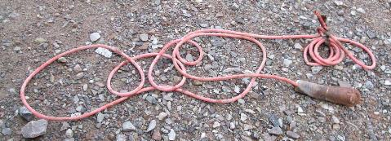
Misfires : Guidance for Quarry Personnel What am I looking for ?
Detonating Cord :
These are continuous string of explosive that looks like washing line or rope and can be of various diameters and colours.
Orange paint has been used in this example to identify the misfire location

Slide 8
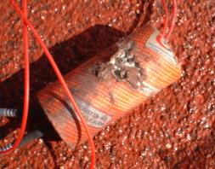
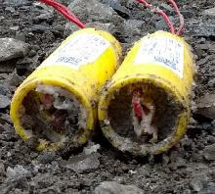
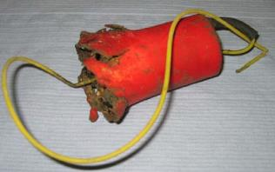
Misfires : Guidance for Quarry Personnel What am I looking for ?
Boosters :
These are about the size of a tin of soup and can often be found with detonators inside.
They are generally brightly coloured

Slide 9
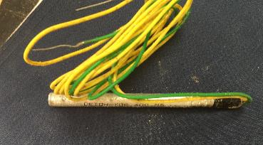
Misfires : Guidance for Quarry Personnel What am I looking for ?
Detonators :
These metal tubes are about the diameter of a pencil and are either made of aluminium or copper. They can either have wires entering one end or a small plastic tube. If they have fired then the end of the detonator will have been blown off.

Slide 10
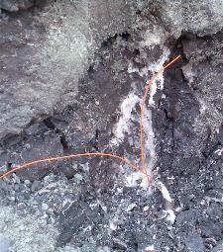
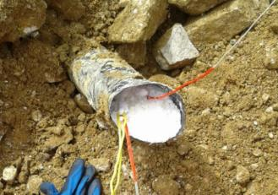
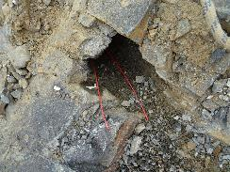
Misfires : Guidance for Quarry Personnel What am I looking for ?
Tubes and/or wires :
The existence or wires or tubes in the muck pile is not automatically an indication of a misfire. However, if the wires or tubes lead to a blast hole in solid rock then this must be treated as a misfire.
Change pictures

Slide 11
Misfires : Guidance for Quarry Personnel What am I looking for ?
Detonators : Shock-Tube connectors
These small detonators are normally housed in some form of plastic surround.
It is important to note the differences between fired and unfired connectors to avoid unnecessary false alarms although if in doubt ask for help.
The look, design and colour of the connectors varies with the differing manufacturers and each of the main suppliers has provided information on the following pages to help with identification.
If you find an unfired connector then you should follow the misfire procedure.

Slide 12
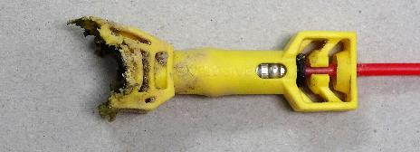
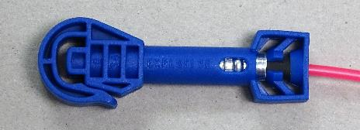
Misfires : Guidance for Quarry Personnel What am I looking for ?
The colours of the plastic connector block and tubes may vary considerably from those shown
Detonators : Shock-Tube connectors
Products from EPC-UK
Fired Connector
Unfired Connector

Slide 13
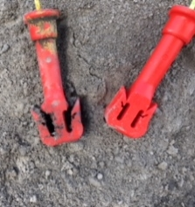
Misfires : Guidance for Quarry Personnel What am I looking for ?
The colours of the plastic connector block and tubes may vary considerably from those shown
Detonators : Shock-Tube connectors
Products from EDL
Fired Connector (top of picture)
Unfired Connector
(bottom of picture

Slide 14
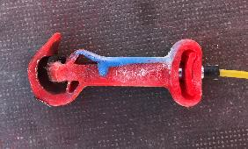
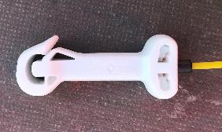
Misfires : Guidance for Quarry Personnel What am I looking for ?
The colours of the plastic connector block and tubes may vary considerably from those shown
Detonators : Shock-Tube connectors
Products from Maxam
Fired Connector
Unfired Connector

Slide 15
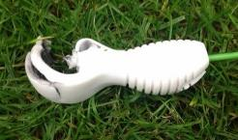
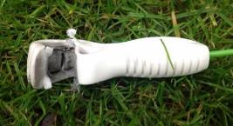
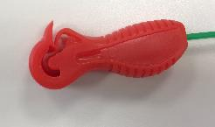
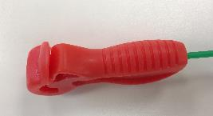
Misfires : Guidance for Quarry Personnel What am I looking for ?
The colours of the plastic connector block and tubes may vary considerably from those shown
Detonators : Shock-Tube connectors
Products from Orica
Fired Connector
Unfired Connector

Slide 16
Misfires : Guidance for Quarry Personnel What should I do ?
On discovering or suspecting a misfire you should take the following steps
STOP Immediately stop any excavation or processing activities Do not handle the misfire
COMMUNICATE Contact the responsible manager – normally the quarry manager
PREVENT Clear the area and ensure that people do not enter
WAIT Wait for the responsible manager to visit and then follow their instructions

