Slide 1
QNJAC – Road Haulage sub-committee
Vehicle breakdowns
Toolbox talk

Slide 2
Target audience
All those responsible for maintaining the safety of persons involved in, or impacted by, road haulage in the event of a vehicle breakdown
Drivers
Breakdown Maintenance
Maintenance staff
Hauliers/Fleet Owners
Site Operators & Management

Slide 3
Who is at risk during vehicle breakdowns?
Drivers
Site employees
Vehicle Maintenance Staff
Pedestrians
Other road users

Slide 4
The Law
If a driver operates a vehicle which hasn’t been properly maintained, both the haulier and driver may be responsible for seriously injuring themselves or others, perhaps even fatally.
In the event of a vehicle breakdown, they will also be responsible for ensuring that the repair &/or recovery of the vehicle is undertaken safely
The transport manager may be responsible if he has not operated a maintenance system in line with the VOSA Licensing requirements
The vehicle maintenance personnel may be responsible if they have not carried out the maintenance work appropriately or dealt with the defects that were assigned to them
In addition, all other parties involved in managing the process at the loading and discharge locations, may also be held responsible. This would include quarry operators, customers and site managers.
Employers, owners and managers have a responsibility to provide and maintain safe systems of work, and to take reasonable and practical precautions to ensure the health and safety of all workers and members of the public who may be affected by their activities.
All drivers, including the self employed, have a responsibility for their own health and safety, and that of other people who could be affected by their actions

Slide 5
Hauliers/Fleet owners responsibilities
Ensure all vehicles supplied are fit for purpose, and are well maintained
Maintain all records of maintenance and inspections of the vehicles
Establish robust procedures to ensure all of your drivers are undertaking pre-start vehicle checks and ensure any defects are appropriately addressed
Ensure drivers are suitably competent to inspect and operate the vehicle and understand which defects require the vehicle not to be operated
Provide all vehicles with the relevant hazard warning equipment for the driver to use in the event of a breakdown

Slide 6
Hauliers/Fleet owners responsibilities (cont.)
Provide drivers with any appropriate generic or specific safety information they may need in the event of a breakdown
Avoid maintaining vehicles on sites but if unavoidable, follow the site rules
Don’t just rely on a maintenance system alone, because this cannot always ensure that vehicles are roadworthy.
Be prepared to provide site operators with a suitable and sufficient Risk Assessment for any emergency repairs which may be necessary on their site

Slide 7
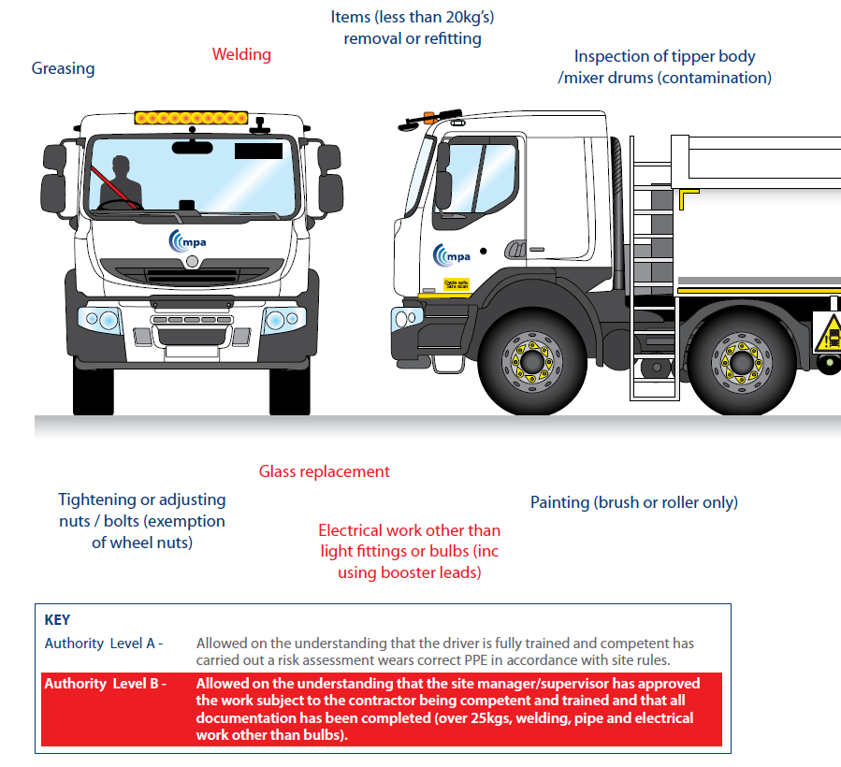
Hauliers/Fleet owners responsibilities (cont.)
Ensure drivers understand what level of repairs they are authorised to undertake.
Consider an authority level system, as recommended by the MPA (Drivers Handbook)

Slide 8
Hauliers/Fleet owners responsibilities (cont.)
Ensure maintenance staff are trained and issued with any relevant Risk Assessments &/or Safe Systems of Work covering vehicle repairs
Consider appropriate formal training for maintenance staff to work at the roadside (eg “Survive” and “NTDA”)
Train maintenance staff to be able to undertake Risk Assessments on site, so they are able to spot and control hazards at any particular location
Train drivers in the procedure to be adopted in the event of a breakdown
Provide drivers with a mobile phone to enable them to easily communicate with others in the event of a breakdown

Slide 9
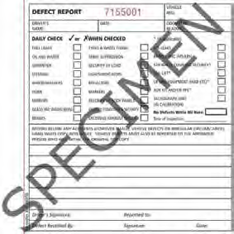
Drivers responsibilities
Carry out the pre start checks – It’s a drivers responsibility to check that the vehicle is fit for purpose. A record of these checks must be maintained
Any defects that pose a significant safety risk should be reported to the relevant supervisor immediately so that appropriate action can be taken, including parking up a truck where necessary.
Don’t attempt to undertake any repairs unless you are trained and competent to do so and have been authorised by your employer
RHA vehicle inspection form

Slide 10
Drivers responsibilities (cont.)
Once loaded and on the highway, drive safely and smoothly, so as not to destabilise the load or put undue stresses on the vehicle
Drive in accordance with the Highway code
Ensure vehicle is adequately fueled and lubricated to complete the journey
If you break down on a site, position and park your vehicle as safely as possible, and report to site staff
If your vehicle catches fire, only attempt to use an on board extinguisher if the fire is small and you have been trained in its use. If not, park up, stay clear and call the emergency services

Slide 11
Site Operators & Management responsibilities
Establish a regime to enable new tipper drivers to be suitably inducted to the site. Where appropriate, provide hard copies of relevant information, such as site layout plans and what to do in the event of a breakdown
Offer the appropriate level of support to vehicle drivers and maintenance staff to enable any breakdown to be resolved quickly and safely.

Slide 12
Site Operators & Management responsibilities (cont.)
Ensure haul roads are designed and properly maintained to minimise the likelihood of damage to the vehicle
Provide firm level ground at all areas where loading is planned
Have plans in place so that on the rare occasion that it is necessary to perform emergency repairs on site, personnel are aware of the procedure and where and how this work can be undertaken safely
Provide a relevant site induction to any any arriving maintenance staff and check they are suitably trained and competent,
Where appropriate, ensure that a Risk Assessment will be undertaken and check it to ensure it is of sufficient quality
to cover the work

Slide 13
Vehicle Maintenance Staff responsibilities
Maintain the vehicle in accordance with the VOSA Operators Licence conditions
Complete records of maintenance and pass these to the operator
Carry out inspection and maintenance in line with Company Systems
When attending breakdowns, be aware of the Safe Systems of Work to be adopted

Slide 14
Vehicle Maintenance Staff responsibilities (cont.)
Respond and rectify defects in a timely manner dependent on safety critical nature of defect
Carry out quality work
Ensure the area is left clean and tidy and dispose of any waste appropriately

Slide 15
What to do in the event of a vehicle breakdown – Highway
If your vehicle breaks down on the highway, think first of other road users and;-
DO – Ensure where possible that the vehicle comes to rest in a suitable place at the nearside or away from the carriageway. This will minimise disruption to other road users
DO - Exit vehicle cab on the non traffic side
DO - Warn other traffic by using your hazard warning lights if your vehicle is causing an obstruction
DO - Stay in a safe location away from the vehicle if it is safe to do so
DO - Help other road users see you by ensuring you, and any passengers wear high visibility reflective clothing/work wear

Slide 16
What to do in the event of a vehicle breakdown – Highway
If your vehicle breaks down on the highway, think first of other road users and;-
DO - Put a warning triangle on the road at least 45 metres behind your broken-down vehicle on the same side of the road, or use other permitted warning devices if you have them, if it is safe to do so. Always take great care when placing or retrieving them
DO - Keep your sidelights on if it is dark or visibility is poor, if it is possible to do so
DO - Arrange recovery for vehicle specialists
DO - Keep your sidelights on when it is dark or visibility is poor.

Slide 17
What to do in the event of a vehicle breakdown – Highway (cont.)
If your vehicle breaks down on the highway, think first of other road users and;-
DON’T - Attempt to use a warning triangle on a motorway or other
high speed road
DON’T - Put yourself or your passengers in danger
DON’T - Stand (or let anybody else stand) between your vehicle and oncoming traffic
DON’T - Stand where you will prevent other road users seeing your lights at night or in poor visibility.

Slide 18
What to do in the event of a vehicle breakdown – Off Highway
If your vehicle breaks down off highway at the loading or discharge site;-
Contact the weighbridge/ site control point via telephone or ask the site staff to make contact with the weighbridge/ site control point
Remain in your cab if it is safe to do so
Be guided by the site supervisory management as to how to proceed
Don’t try and sort the problem out yourself without guidance from site personnel as you may be unaware of the risks that you face in that environment

Slide 19
What to do in the event of a vehicle breakdown - Motorway
DO – Ensure where possible that the vehicle comes to rest in a suitable place at the nearside or away from the carriageway. This will minimise disruption to other road users
DO - Stay in a safe location away from the vehicle if it is safe to do so. If you break down on a contraflow section without a hard shoulder, stay with your vehicle
Do phone the emergency services and try to be specific about your location using marker posts and signage to help them locate you quickly
Do be guided by the Highways Agency on how to proceed with your repair and recovery

Slide 20
What to do in the event of a vehicle breakdown – Motorway (cont.)
DON’T – Allow a wheel to run off onto the grass verge when stopping on the hard shoulder
DON’T – Walk on the carriageway

Slide 21
Conclusion
REDUCING THE FREQUENCY AND MINIMISING THE RISKS ASSOCIATED WITH VEHICLE BREAKDOWNS REQUIRES A TEAM EFFORT

Slide 22
References
FTA Drivers handbook
MPA Drivers handbook
“Survive best practice guidelines”
The Highway code
HSE “Vehicle maintenance”
HSE “Roadside recovery and repair”
HSE “A guide to workplace transport safety”

