Slide 1
QNJAC Joint Drill, Blast and Geotechnical Group Toolbox Talk - Face Surveying
This toolbox talk is aimed at Quarry Managers, supervisors and those persons responsible for implementing the recommended measures from Geotechnical Assessments and managing the surveying operation.

Slide 2
All faces to be blasted require a face survey to be carried out
Personnel carrying out the surveying must be trained, authorised and competent to carry out the task and have good knowledge of the quarry and location of the intended area to be blasted.

Slide 3
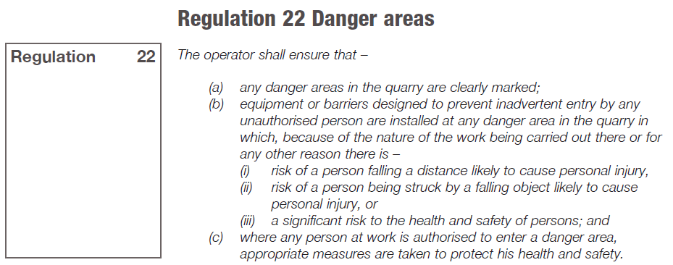
Use of danger areas within the Quarry Excavation Quarries Regulations 1999, Regulation 22 describes their use

Slide 4
Profiling - Toe of the face
In order for the blast to be designed to be safe then the toe of the face must be visible to the profiling equipment.
This can conflict with the positioning of the rock trap and demarcation bunds.
Quarry management should be aware of this and the following methods can be used to allow safe access by profiling staff to view toes:-
1, Make a hole in the bund at regular intervals by making an overlapped bund,
2, putting pop stones in the bund,
3, making a platform in the bund,
4.accessing another area to view the toe,
5, Use of All terrain Mobile elevated working platform (MEWP) , etc
This should be based on site conditions / specifics and risk assessment

Slide 5
“... where necessary the excavation area must be isolated by physically prohibiting access or clearly demarcating exclusion areas...”
Measures need to be adequate and risk based
Balanced against requirements for face profiling
Working faces require demarcation to prevent inadvertent access

Slide 6
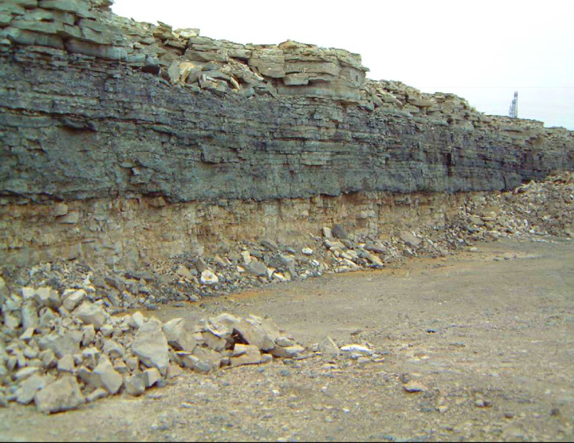
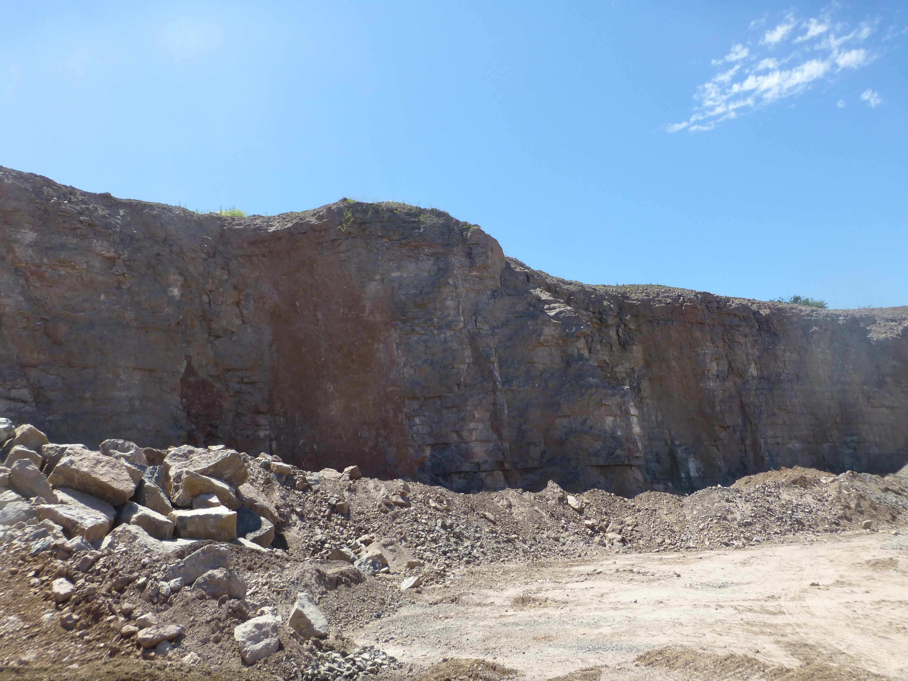
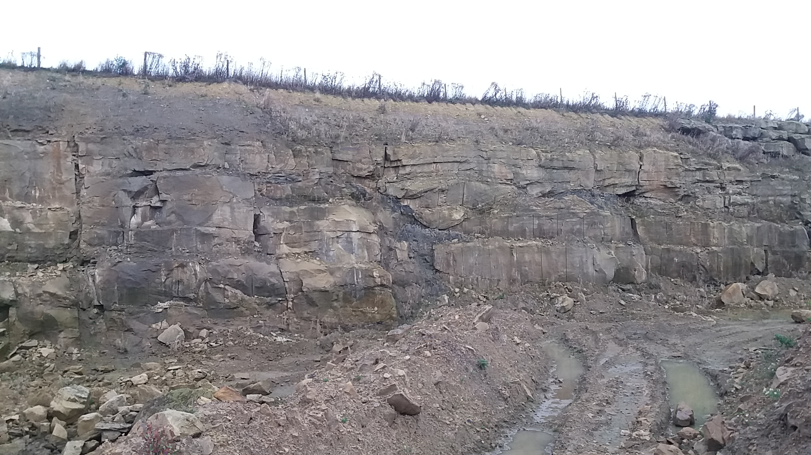
Why isolate faces? To avoid inadvertent entry to danger areas
Rock Trap Bunds...... Close to face where it both demarcates and acts as a rock trap
If the face needs to be profiled as it is the next intended face to be fired the rock trap needs to be removed to allow full height and width of the planned area to be profiled before the design can be carried out.
Rock Trap further out from face No rock trap
I
Rock trap too close to the face for surveying

Slide 7
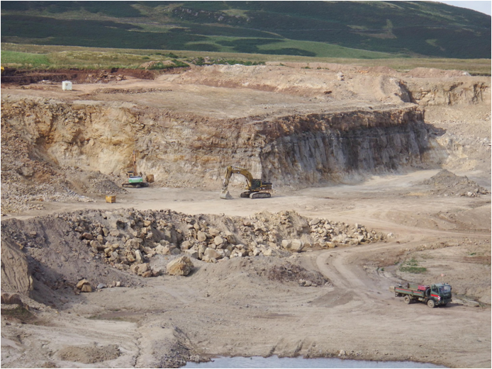
Demarcation bunds...... remote from the working face
Needs to be based on risk assessment, as no physical protection. Consider face condition
Only for areas where risk assessed activities are safe to be carried out? e.g. Loading out from shot piles
How do you control inadvertent access close to a face within the demarcated area?
How do you manage change within the demarcated area?
Too great a distance will devalue the demarcation as it becomes less relevant keep the demarcation close but enough room from the toe so the survey can be taken of the whole area of the intended face to be fired
By risk assessment a demarcation area needs to be put in place depending on the risks this could be cones, bund, pop stones or signs so a full survey of the face can take place prior to the creation of the blast design
Use pads for surveyors

Slide 8
If the purpose of the bund is to catch falling debris off faces it is a rock trap bund.
If it is simply to keep people out of the danger zone (where rocks may fall onto them) it is a demarcation bund.
It is advisable to produce a face profile before drilling with no materials in front of the face.
The survey could be taken from:-
a pad looking over the top
a gap made in the bund to have full visibility of the face in front,
or from a position of safety where there is no bund
If using Drones for face surveying, the toe bund does not need to be removed as the drone can see over it and there is no need for a special safe location to be provided as the drone can be flown from any such location.

