Slide 1
Quarries Regulation 1999 Regulation 32 Appraisal of excavations and tips
Notes:
*
Quarries Regulation 1999 Regulation 32 Appraisal of excavations and tips

Slide 2
Regulation 32
Appraisals conducted in accordance with Regulation 32 are a vital part of the safe systems of work and are mandatory under the law, However, the process is often misunderstood and compliance is often poor, the following guidance is intended to provide some clarity on the process of Regulation 32 Appraisals.
Notes:
*
All quarry operators are required by Regulation to determine whether any geotechnical element within an active quarry represents a threat to anybody. All excavations and tips however small or large are considered potential hazards and Regulation 32 outlines the formal process that must be undertaken to determine the degree of hazard for each element.
If an excavation or tip is identified as having the potential to cause harm then it is deemed a potential “Significant Hazard” and it must be “Assessed” by a “Geotechnical Specialist” to determine the level of risk.
Remember also that Stockpiles and Lagoons are classified as Tips by Regulation. Such existing or proposed features on site must be subject to an Appraisal if they have not been previously determined to be a Significant Hazard.

Slide 3
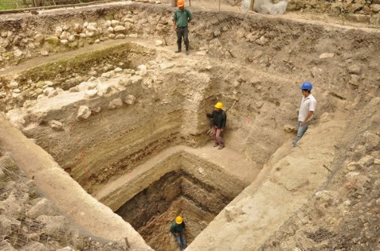
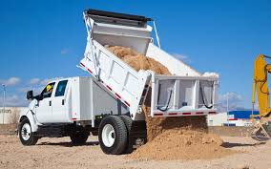
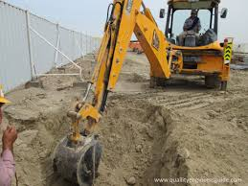
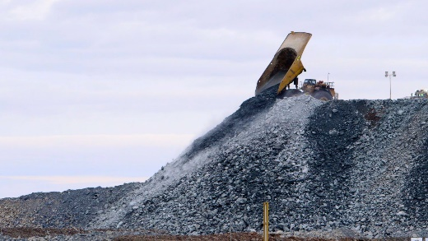
What is the purpose of an appraisal?
All appraisals must come to a conclusion as to whether a significant hazard is present or will be created.
If the appraisal concludes that a significant hazard is not likely then further appraisals should be conducted at appropriate intervals or whenever there is reason to suspect a significant change.
If the appraisal concludes that a significant hazard is likely then a geotechnical specialist must be consulted as soon as possible.
Note: It is good practice to involve a geotechnical specialist in the design of any planned excavation or tip which is likely to represent a significant hazard when constructed.
NB The HSE must be notified at least 30 day before work starts on construction of a significant hazard
Notes:
*
Speaker Notes:
The purpose of an appraisal is simply to determine if a significant hazard is present or will be created. The person conducting the appraisal must conclude (in writing) if a significant hazard is present or not. If you do not reach a conclusion you have not completed the appraisal.
Significant hazards will always require the attention of a geotechnical specialist, excavations and tips that are not significant hazards may not require such specialist attention.

Slide 4
When should appraisal be carried out?
All Proposed (Planned) Excavation and or Tips must have an appraisal before work starts.
All proposed excavations and tips (tips include all; overburden dumps, backfill, spoil heaps, stock piles, fill ramps, screening mounds and lagoons) must have in place an appraisal before construction commences.
It does not matter how small or how large these are all require appraisals
Notes:
*
Speaker Notes:
All planned and existing Excavations or Tips (tips include all; overburden dumps, backfill, spoil heaps, stock piles, fill ramps, screening mounds and lagoons) must be appraised to determine if they present a significant hazard.
If the appraisal concludes that there is no significant hazard then further appraisals should be conducted at appropriate intervals or whenever there is reason to suspect a significant change.
If the appraisal concludes that there is or will be a significant hazard then a geotechnical assessment is required as soon as is reasonably practicable.
Note: It is good practice to involve a geotechnical specialist in the design of any planned excavation or tip which is likely to represent a significant hazard when constructed.

Slide 5
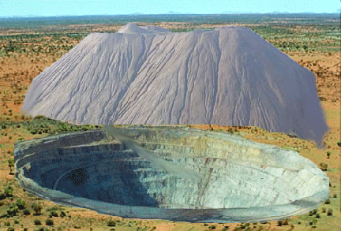
When should appraisal be carried out?
All Existing Excavations and Tips must have an appraisal and this appraisal must be repeated at an appropriate interval.
Notes:
*
Speaker Notes:
All planned excavations or tips must have an appraisal before work commences.
If the appraisal concludes that a significant hazard will be created then a geotechnical specialist must be consulted and a geotechnical assessment of the design will usually be required. If the geotechnical specialist confirms that the structure is a significant hazard it becomes a notifiable structure and appropriate notification must be sent to the HSE (see QNJAC Geotechnics Information Sheet 4 October 2012 Duties of the Operator)
The excavation or tip will then be subject to regular geotechnical assessments until such time as it no longer represents a significant hazard, when appraisals will recommence.
If the initial appraisal concludes that no significant hazard will be created then the appraisal should be repeated at appropriate intervals or whenever significant change is either suspected or occurs. Good practice would suggest that an appraisal is repeated following completion of the works and at intervals of not more than two years thereafter.

Slide 6
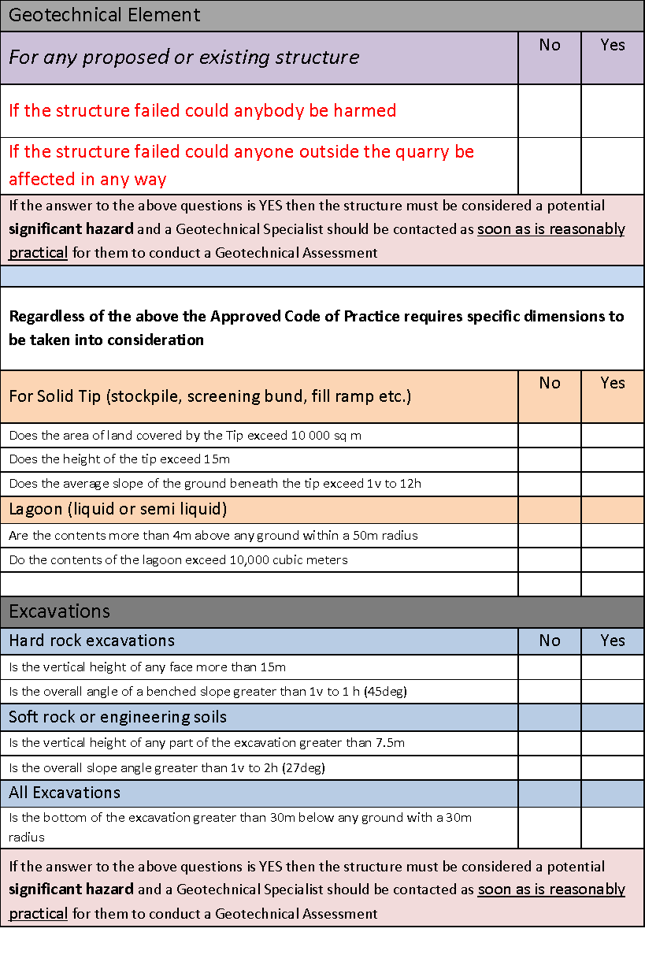
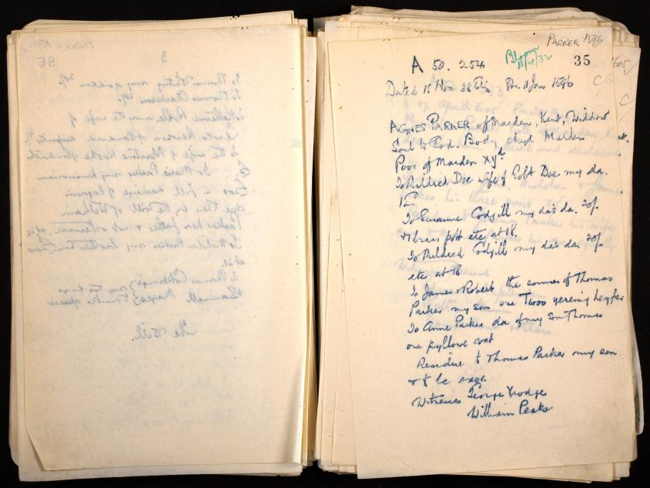
What records must be kept?
All appraisals must be recorded in writing and must give reasons why the conclusion was reached.
Notes:
*
Speaker Notes:
The person conducting the appraisal must record the reasons for reaching his/her conclusion and sign and date the record. All appraisals must be kept as part of the site documentation and must be available for inspection by anyone employing people at the quarry or anyone working at the quarry.

Slide 7
What records must be kept?
All appraisals must be signed and dated by the person conducting them.
Notes:
*
All appraisals must be signed and dated by the person conducting them.

Slide 8
Who is entitled to see appraisals ?
All appraisals must be kept as part of the site documentation and must be available for inspection by anyone employing people at the quarry or anyone working at the quarry.
Notes:
*
All appraisals must be kept as part of the site documentation and must be made available to anyone employing people at the quarry or anyone working at the quarry.
During inductions do you ask the question “do you want to see the geotechnical appraisals”?
Speaker Notes:
Reg 32 (c) the record made in accordance with sub-paragraph (a) is made available to each employer of persons at work at the quarry and to all persons at work at the quarry.”

Slide 9
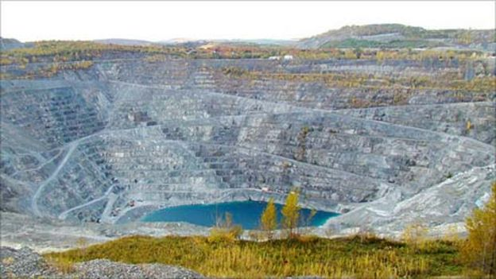
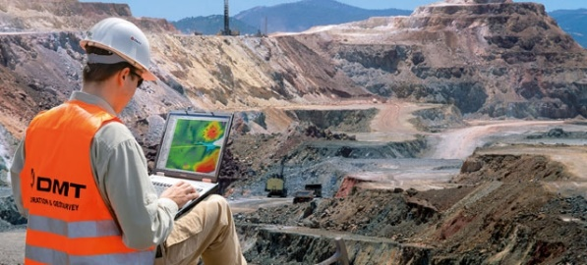
However !
Where an excavation or tip has already been identified as a significant hazard further appraisals are not appropriate, any significant change to a significant hazard requires a further Geotechnical Assessment by a geotechnical specialist.
Notes:
*
Where an excavation or tip has already been identified as a significant hazard further appraisals are not appropriate, any significant change to a significant hazard requires a revision of the Geotechnical Assessment by the geotechnical specialist.

Slide 10
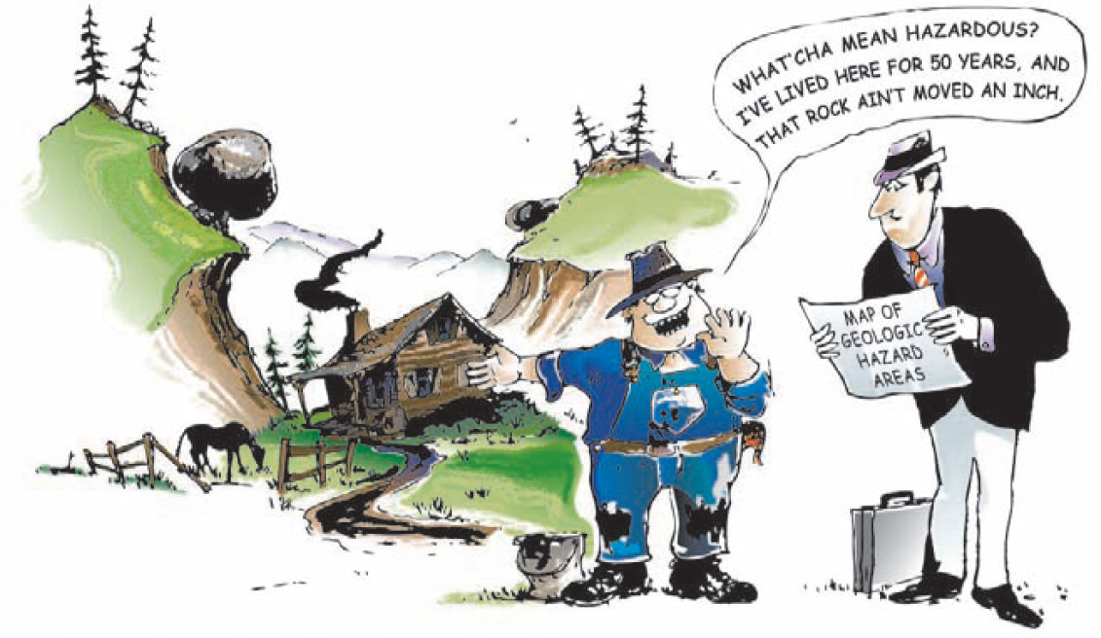
Who should conduct appraisals?
An appraisal is intended to be a fairly straight forward exercise, it should be carried out in enough detail and with sufficient expertise to decide if an excavation or tip poses a significant hazard from collapse or movement.
Notes:
*
An appraisal is intended to be fairly straight forward, it should be carried out in enough detail and with sufficient expertise to decide if an excavation or tip poses a significant hazard from collapse or movement.
Appraisals can be conducted by any competent person, that is, a person with sufficient training, experience, knowledge and other qualities to enable him / her to undertake such duties.
It is not normally necessary for appraisals to be carried out by a geotechnical specialist, in fact the frequency at which appraisals should be completed would make the involvement of a geotechnical specialist in all appraisals impractical.

Slide 11
Who should conduct appraisals?
Appraisals can be conducted by any competent person, that is, a person with sufficient training, experience, knowledge and other qualities to enable him / her to undertake such duties.
Notes:
*
Appraisals can be conducted by any competent person, that is, a person with sufficient training, experience, knowledge and other qualities to enable him / her to undertake such duties.

Slide 12
Who should conduct appraisals?
It is not normally necessary for appraisals to be carried out by a geotechnical specialist, in fact the frequency at which appraisals should be completed would make the involvement of a geotechnical specialist in all appraisals impractical.
Notes:
*
It is not normally necessary for appraisals to be carried out by a geotechnical specialist, in fact the frequency at which appraisals should be completed would make the involvement of a geotechnical specialist in all appraisals impractical.

Slide 13
How frequently should appraisal be conducted?
All planned excavations or tips must have an appraisal before work commences.
If the appraisal concludes that a significant hazard will be created then a geotechnical specialist must be consulted and a geotechnical assessment / design will usually be required. The excavation or tip will then be subject to regular geotechnical assessments until such time as it no longer represents a significant hazard, when appraisals will recommence.
If the initial appraisal concludes that no significant hazard will be created then the appraisal should be repeated at appropriate intervals or whenever significant change is either suspected or occurs. Good practice would suggest that an appraisal is repeated following completion of the works and at intervals of not more than two years thereafter.
Notes:
*
All planned excavations or tips must have an appraisal before work commences.
If the appraisal concludes that a significant hazard will be created then a geotechnical specialist must be consulted and a geotechnical assessment / design will usually be required. The excavation or tip will then be subject to regular geotechnical assessments until such time as it no longer represents a significant hazard, when appraisals will recommence.
If the initial appraisal concludes that no significant hazard will be created then the appraisal should be repeated at appropriate intervals or whenever significant change is either suspected or occurs. Good practice would suggest that an appraisal is repeated following completion of the works and at intervals of not more than two years thereafter.

Slide 14
How do I decide what represents a significant hazard?
When conducting an appraisal you should focus on what the consequences of failure would be, the probability of a failure actually happening is not relevant here.
The hazard should be considered significant if failure would directly or indirectly be liable to endanger premises, roadways or other places where people are likely to be found off site, or likely to kill or seriously injure anyone.
The ACOP accompanying the 1999 quarries regulations provides clear guidance on what should be regarded as a significant hazard, this guidance is reproduced below.
Notes:
*
When conducting an appraisal you should focus on what the consequences of failure would be (the hazard), the probability of a failure actually happening is not relevant here.
The hazard should be considered significant if a failure would directly or indirectly be liable to endanger premises, roadways or other places where people are likely to be found off site, or likely to kill or seriously injure anyone.
The ACOP accompanying the 1999 quarries regulations provides clear guidance on what should be regarded as a significant hazard, this guidance is reproduced as Table 1 below.

Slide 15
How do I decide what represents a significant hazard?
To determine if the hazard is significant it is necessary to consider how an excavation or tip might feasibly fail, or cause adverse effect other nearby property and structures and the likely consequences of any such failure or effect. The likely consequences are crucial when deciding if a particular hazard is significant. The probability of such a failure actually happening is not relevant.
The hazard should be considered significant if such a failure would, directly or indirectly, be:
(a) liable to endanger premises, roadways or other places where people are likely to be found off-site; or
(b) likely to kill or seriously injure anyone.
Notes:
Speaker Notes:
Significant hazard
ACOP 293 says: To determine if the hazard is significant it is necessary to consider how an excavation or tip might feasibly fail, and the likely consequences of any such failure. The likely consequences are crucial when deciding if a particular hazard is significant. The probability of such a failure actually happening is not relevant in this context. However this description should be expanded to consider how the formation or management of the excavation could affect the stability of the of excavation or tip and also any nearby properties and structures. Examples of how the formation of the excavation might be an issue include vibration due to blasting or settlement due to dewatering.
ACOP 295 says: The hazard should be considered significant if such a failure would, directly or indirectly, be: liable to endanger premises, roadways or other places where people are likely to be found off-site; or likely to kill or seriously injure anyone. Timescale and distance is not addressed in the ACOP and the focus is on immediate loss of life on site, but plausibly loss of life can occur over a protracted period and outside of site. An example might be if a utility service was disrupted to vulnerable customers/infrastructure.
The QR’99 and ACOP do not define structure, but the Construction Design Management (CDM) Regs 2015 do. “structure” means - (a) any building, timber, masonry, metal or reinforced concrete structure, railway line or siding, tramway line, dock, harbour, inland navigation, tunnel, shaft, bridge, viaduct, waterworks, reservoir, pipe or pipeline, cable, aqueduct, sewer, sewage works, gasholder, road, airfield, sea defence works, river works, drainage works, earthworks, lagoon, dam, wall, caisson, mast, tower, pylon, underground tank, earth retaining structure or structure designed to preserve or alter any natural feature and fixed plant; (b) any structure similar to anything specified in paragraph (a); (c) any formwork, falsework, scaffold or other structure designed or used to provide support or means of access during construction work, and any reference to a structure includes part of a structure.
Schedule 1 REG 331a indicates any contiguous land or structures which might be affected by the excavation or tip should be on the site survey and lists other features be them natural or man-made which might affect the safety of the excavation. The assessor should be aware that some structures or hazards are buried underground and therefore are not always obvious. If the assessor has not already checked the Site Survey and services search, they should do so before undertaking the appraisal.
Adverse effects from forming the excavations might include; vibration from blasting and the operation of the haulage route, loading from haulage or stockpiles, settlement or change in water-table/water flow regime due to dewatering, increased flooding risk due to bunds and altered run-off conditions.
Structures should be considered to include any part of, or support/access to: any building, road, railway or tramway lines, dock/harbour, inland navigation, tunnel, bridge, viaduct, shaft, waterworks, reservoir, dam, aqueduct, pipe or pipeline, gasholder, cable, sewer, sewage works, airfield, sea defence works, river works, drainage works, earthworks, lagoon, wall, caisson, mast, tower, pylon, underground tank, earth retaining structure or structure designed to preserve or alter any natural feature and fixed plant or similar.
You should be aware that some structures may be buried underground such as utility services and culverts and are therefore not always obvious.

Slide 16
ADVERSE EFFECTS?
Railway lines
Pylons
Pipelines
Tunnels
High voltage overheads
Reservoir
Other Buried services (eg High Pressure Gas, Storm Drain, Water Pipes etc)
Rivers and watercourse
Residential properties
Notes:
Here is a list of elements that may be affected by your existing or planned excavation or tip.
The following slides give photographic examples of some of these.
Think about the cost and disruption to services that could have been avoided by following the appropriate Geotechnical management pathway.

Slide 17
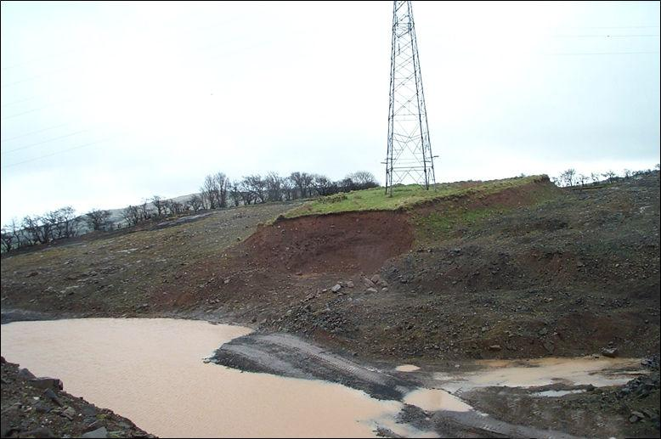
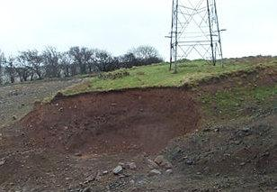
ADVERSE EFFECTS?
Pylons
Notes:
Undermining of Pylons can both affect their stability and increase the likelihood of both disruption to the supply network and danger to persons from contact with High voltage conductors.

Slide 18
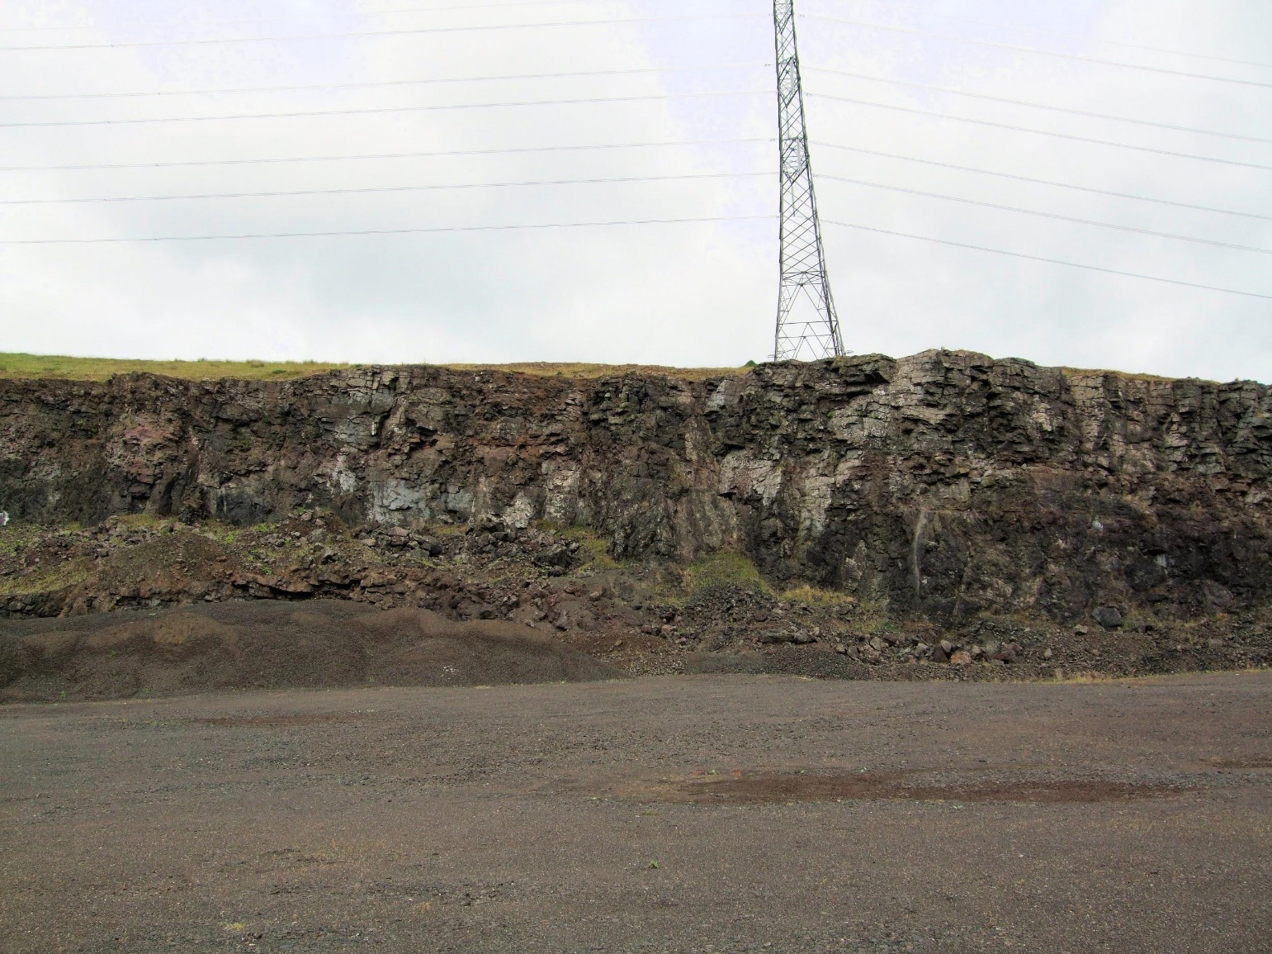
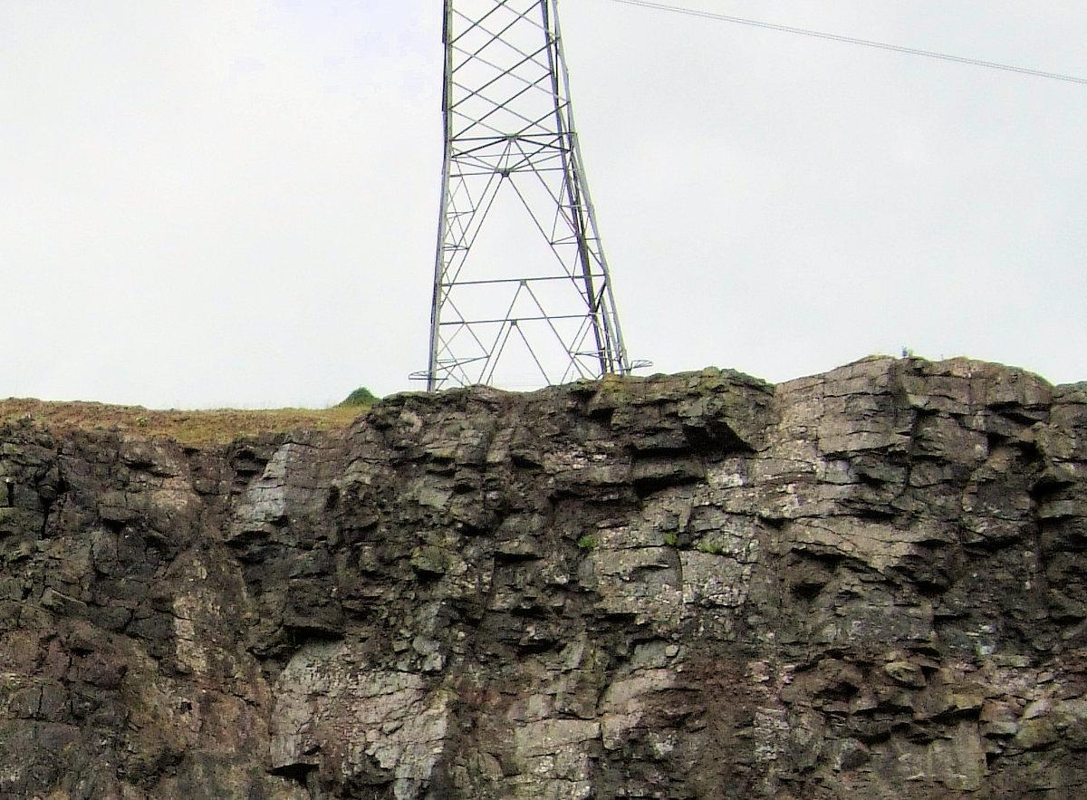
ADVERSE EFFECTS?
Pylons
Notes:
Blasting near pylons brings its own set of risks and therefore necessary controls.

Slide 19
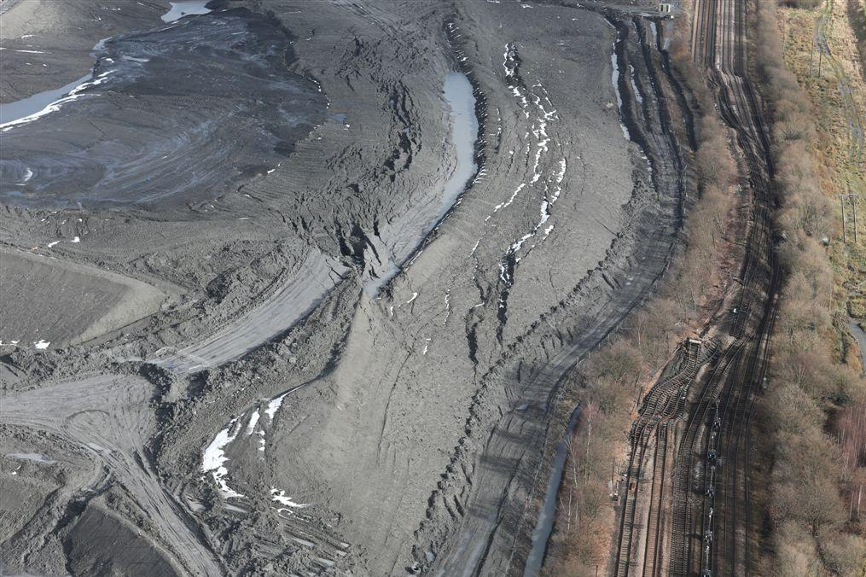
ADVERSE EFFECTS?
Railways
Notes:
1000 000 m3 had to be moved to reinstate the railway. This failure of a mine coal spoil tip led to significant disruption to the railway at Hatfield

Slide 20
How do I decide what represents a significant hazard?
Regulation
Approved Code of Practice
Notes:
*
A significant hazard is defined in the Approved Code of Practice as
Para “295 The hazard should be considered significant if such a failure would, directly or indirectly, be:
a) liable to endanger premises, roadways or other places where people are likely to be found off-site; or
(b) likely to kill or seriously injure anyone”.
In addition to ACOP Guidance in Para 295 further focus should also be given to premises and roadways, and also on less obvious areas of concern such as waterways, old mineral workings, transmission lines, pipe lines and similar.

Slide 21
Appraisal Flow Chart
Does/will
the proposed or
Appraisal
Reg 32
existing tip or excavation
create a significant
hazard on or
off site
Information
Location
Design
Construction
Inspection
Workforce
Yes?
No?
Protection from harm is an absolute duty
Reg 30
Stability is Not the question here
Notes:
*
Flow Chart for Appraisal.
Do you have all the relevant information?
Location – in the first instance in relation to people who might be in harms way - review all adjacent structures such as footpaths, roadways, water ways, all services electric, gas, communication – any other. What are the consequences of disruption?
It is important to make clear that it is not the task of an Appraisal to take into account the RISK of actual failure of the excavation or tip.
It is the possible consequences of failure that are important.

Slide 22
Appraisal Flow Chart
Review
Does/will
Appraisal
the proposed or
existing tip or excavation
create a significant
hazard on or
off site
No
Carry out next appraisal when
specified or in the event of change
or discovery likely to significantly
increase hazard
Yes
No
Does the
geotechnical
specialist agree that the
hazard is/is likely to be
significant
Yes
Notes:
*
The question “Does the Tip/Excavation create a significant hazard Yes or No” this must be answered in an appraisal.
It is important to demonstrate you have considered who might be at risk.
This can be done in the conclusions.
Any doubt answer YES.
If No the Appraisal must be reviewed at an appropriate interval.
If Yes the appointed Geotechnical Specialist must be consulted.

Slide 23
Appraisal Flow Chart
No
Yes
Does the
geotechnical
specialist agree that the
hazard is/is likely to be
significant
Yes
Complete Geotechnical Assessment
Review
Design
Working Methods
Rules
Inspection scheme
Necessary remedial work
Date of next assessment
Geotechnical Assessment
Reg 33
Record assessment Conclusions
Notify HSE
Reg 37
Carry out next assessment when
specified or in the event of change likely to significantly increase hazard
Reg 34
Notes:
*
Once an Appraisal recognises a “significant hazard” the Appraisal is essentially complete.
The work of an Assessment must be completed before a notification can be sent to the HSE.
If it is an existing structure this work must be done as soon as possible.
The courts have determined that this cannot be delayed because of cost.

Slide 24
Appraisal Flow Chart
Does/will
Review
the proposed or
create a significant
existing tip or excavation
hazard on or
off site
No
Carry out next appraisal when
specified or in the event of change
or discovery likely to significantly
increase hazard
Appraisal
No
Appointed Competent Person
Yes
Does the
geotechnical
specialist agree that the
hazard is/is likely to be
significant
Yes
Geotechnical Assessment
Complete Geotechnical Assessment
Review Design
Working Methods
Rules
Inspection scheme
Necessary remedial work
Date of next assessment
Record assessment Conclusions
Notify HSE
Appointed Geotechnical Specialist
Carry out next assessment when
specified or in the event of change likely to significantly increase hazard
Notes:
*

Slide 25
The End
Any Questions?

Slide 26
Geotechnical risk management mechanisms for proposed and existing Excavations and Tips
Entry point for
Proposed / existing
Structure
Significant Hazard Identified
Appraisal
by
Competent
person
Conclusion : Not Significant Hazard
Assessment
by
Geotechnical
Specialist
Appraisal:
No hazard to people: no hazard to structures which could impact on people
Review at
appropriate
intervals
Review
if
validity
questioned
Assessment:
Determines Risk
and action required to keep risk to people low.
Review
if
validity
questioned
Review at
least every 2
years
Review at
significant
change to
neighbouring
land
Review at
proposed/
significant
change to
structure
Review at
significant
change to
neighbouring
land
Review at
proposed/
significant
change to
structure
Inputs : Location ; Design ; Construction ; Competences required ; Inspection regime
Inputs : Location ; Design ; Construction ; Competences required ; Inspection regime
Notes:
The first question should be “ Is appraisal the correct pathway for the structure?” In most cases the answer is “Yes” The appraisal mechanism behaves as a gatekeeper for all new structures being proposed or reviewed. If the determination during the appraisal leads the competent person to identify a significant hazard, then only a Geotechnical Specialist can decide when and if it returns to the appraisal loop. There are two interlocking models. Each structure should fall under either the appraisal or assessment category and the movement between the two in terms of risk should be well managed.

Slide 27
Is appraisal the correct framework for the structure?
Risk based
Notes:
The first question should be “ Is appraisal the correct pathway for the structure?” In most cases the answer is “Yes” The appraisal mechanism behaves as a gatekeeper for all new structures being proposed or reviewed. If the determination during the appraisal leads the competent person to identify a significant hazard, then only a Geotechnical Specialist can decide when and if it returns to the appraisal loop. There are two interlocking models. Each structure should fall under either the appraisal or assessment category and the movement between the two in terms of risk should be well managed.

