Slide 1
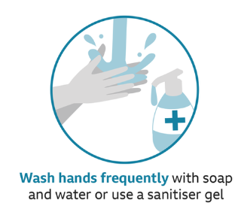
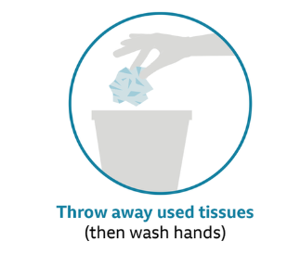
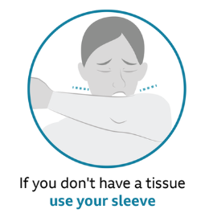
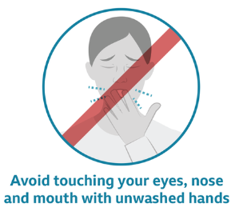
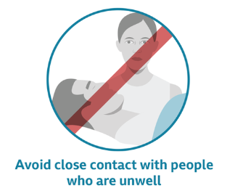
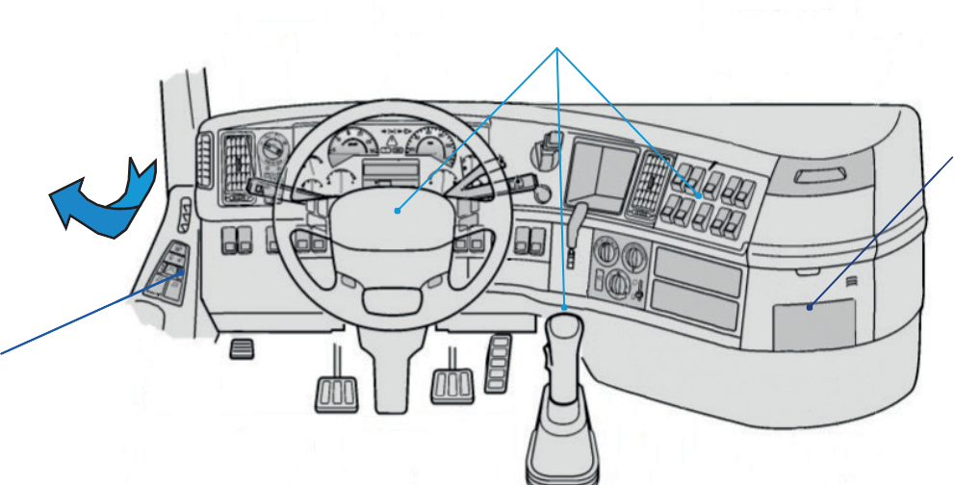
COVID-19 HEALTH & SAFETY
TRUCKMIXER DRIVERS
1
PREVENT CATCHING & SPREADING THE VIRUS
2
YOUR VEHICLE
Maintain cleanliness and hygiene in the cab, clean and disinfect the steering wheel, frequently used levers and buttons, seats and in general anything you usually touch with your hands.
3. Try to have disinfectant gel available.
2. When driving, keep windows half open for ventilation.
4. When cleaning the cab, it is advisable to let it ventilate (10 minutes).
5. Do not operate or board equipment that has not been specifically assigned to you.
V1 – 30/03/2020 1/2

Slide 2
HEALTH & SAFETY
3
CUSTOMER SITES
Use personal protective equipment, including safety glasses and gloves.
Do not share personal protective equipment, pens or other writing instruments.
Assess the work area to ensure you can maintain social distancing at all times, keeping 2 metres between you and anyone else.
Instruct customers to observe social distancing and not to touch any parts of the truck, including hoses and chutes; if customers fail to follow necessary precautions, stop the delivery and leave site.
The requirement for customer signatures has been amended temporarily, sign on glass technology has been suspended in favour of paper tickets. Ask for permission to discharge and enter the name of the customer representative onto the paper ticket and sign on the customer’s behalf. On completion, sign on behalf of the customer as proof of delivery and give a copy of the paper ticket to the customer.
Stay in your truckmixer as far as possible; it is better that you stay isolated inside the vehicle and continue with the necessary hygiene precautions. Before eating anything, you should wash your hands with soap.
Wear gloves to protect hands when using levers, chutes or any tool that someone else may have touched. Remember not to touch your face while using any of these, and to wash your hands once finished.
Avoid crowds in general and respect the minimum distance in waiting rooms, canteens and work areas.
4
GENERAL GOOD PRACTICES
Do not come to work if you have symptoms of COVID-19, including a new, continuous cough or high temperature (over 37.8°C/100F)…Advise your CEMEX contact and ensure you and your fellow householders self-isolate in accordance with Government Guidelines; if you develop symptoms while at work, return home immediately, advise your CEMEX contact and self-isolate.
Keep a hygiene kit (hand sanitiser, disinfectant wipes, etc.) in your vehicle.
Avoid physical contact, no handshakes, etc. and keep a minimum of 2 metres between you and anyone else you interact with.
Avoid communal areas, remain in the cab of your vehicle as far as possible. Respect measures that have been implemented to minimise the spread of infection, such as restricted access to office areas, etc.
Minimise contact with doorknobs or handles, which may have fingerprints, etc.
If sharing a vehicle, before handing over for the next shift, disinfect the keys, cab, door handles, etc. and any other items that have been assigned for your work.
Report any specific concerns to your CEMEX contact.
V1 – 30/03/2020 2/2

